Slide 1
二维卤素钙钛矿ns²孤对电子效应
对光物理性质的影响探究
谷家桢
导师：傅永平 助理教授
2023.09.16

Slide 2
Contents
Part. 1 Introduction
Part. 2 Current Progress
- LPE tuning structural distortions
- LPE tuning PLQY
- LPE tuning exciton diffusivity
Part. 3 Future Plan
- Enhancing LPE in other systems
- LPE tuning exciton diffusivity
- LPE tuning excited-state properties

Slide 3
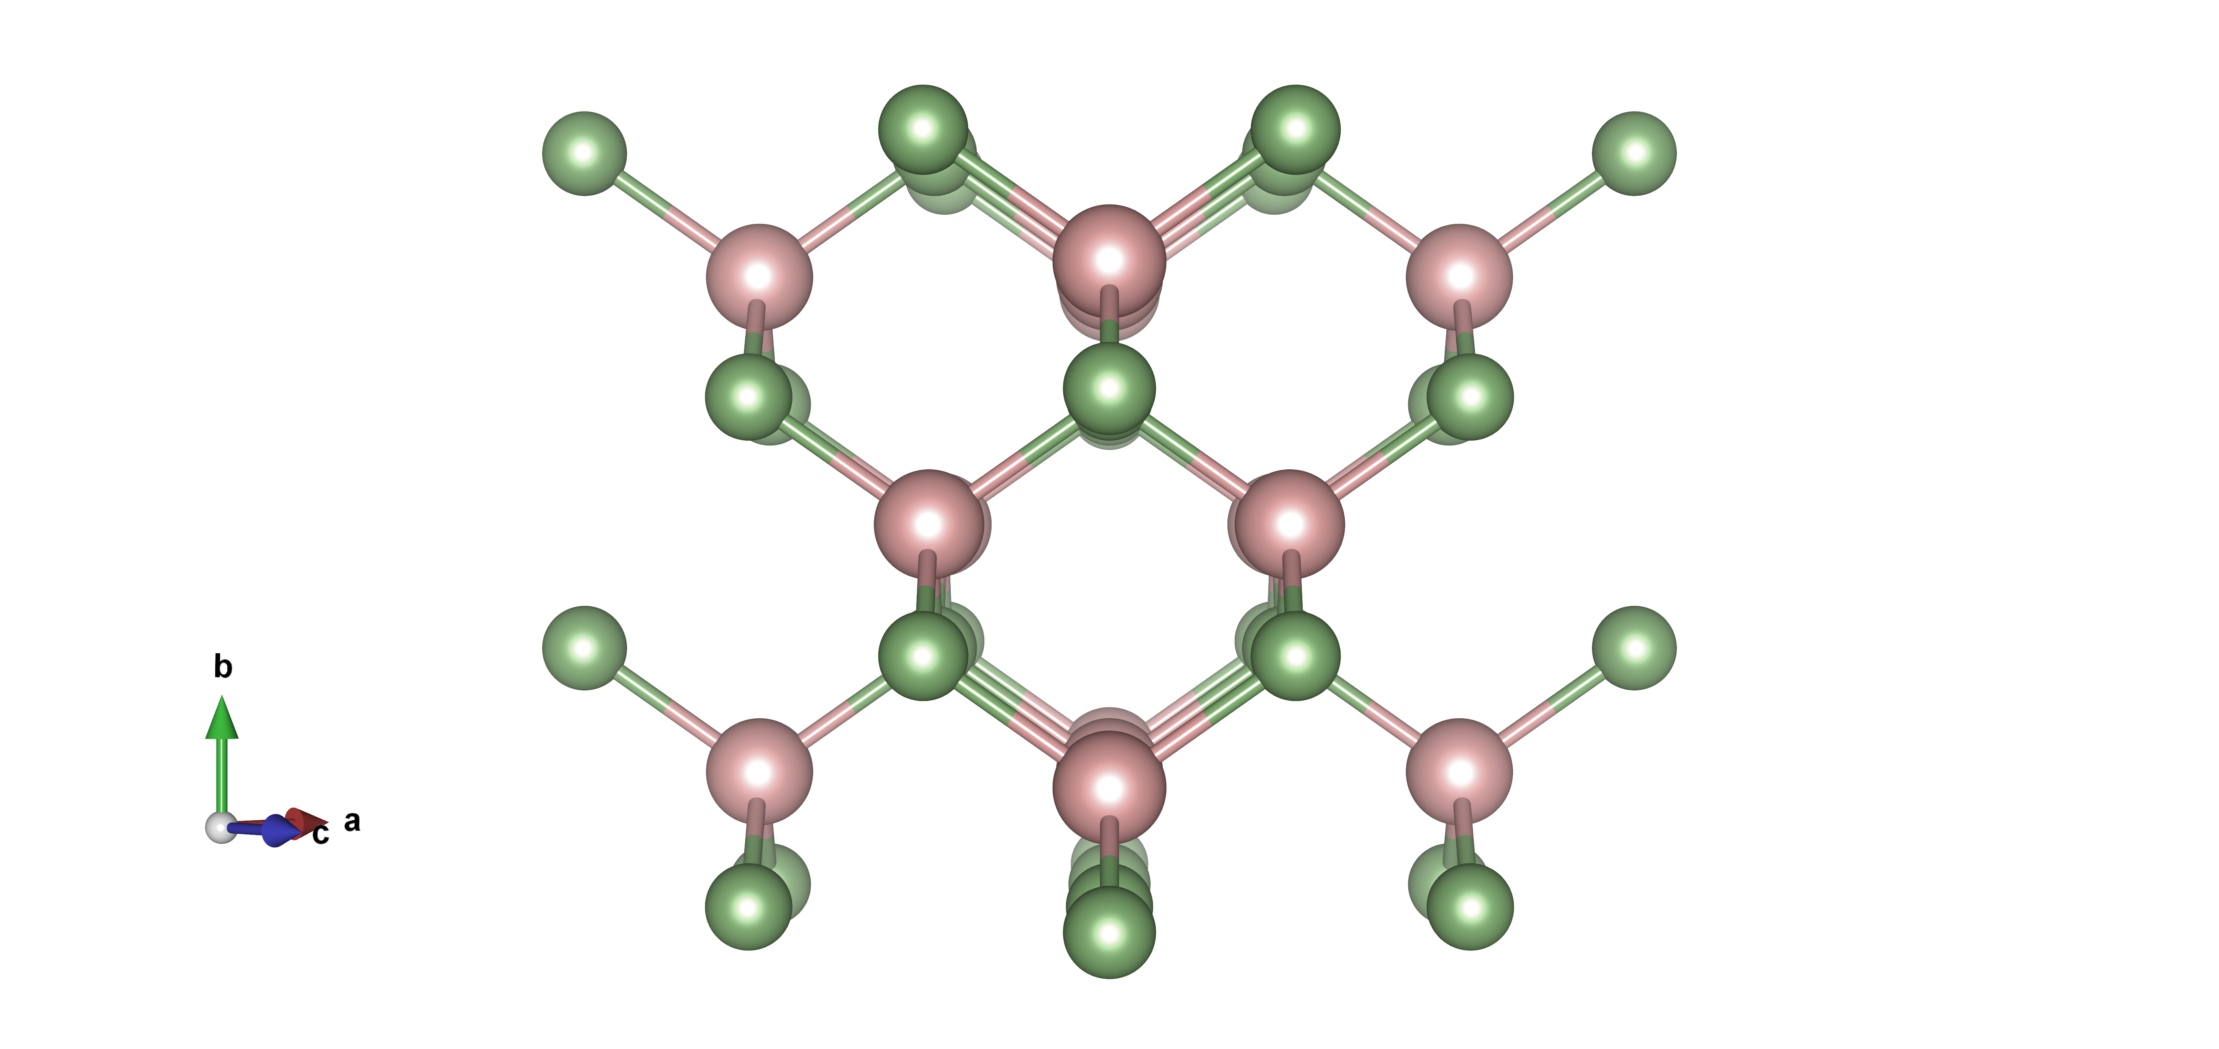
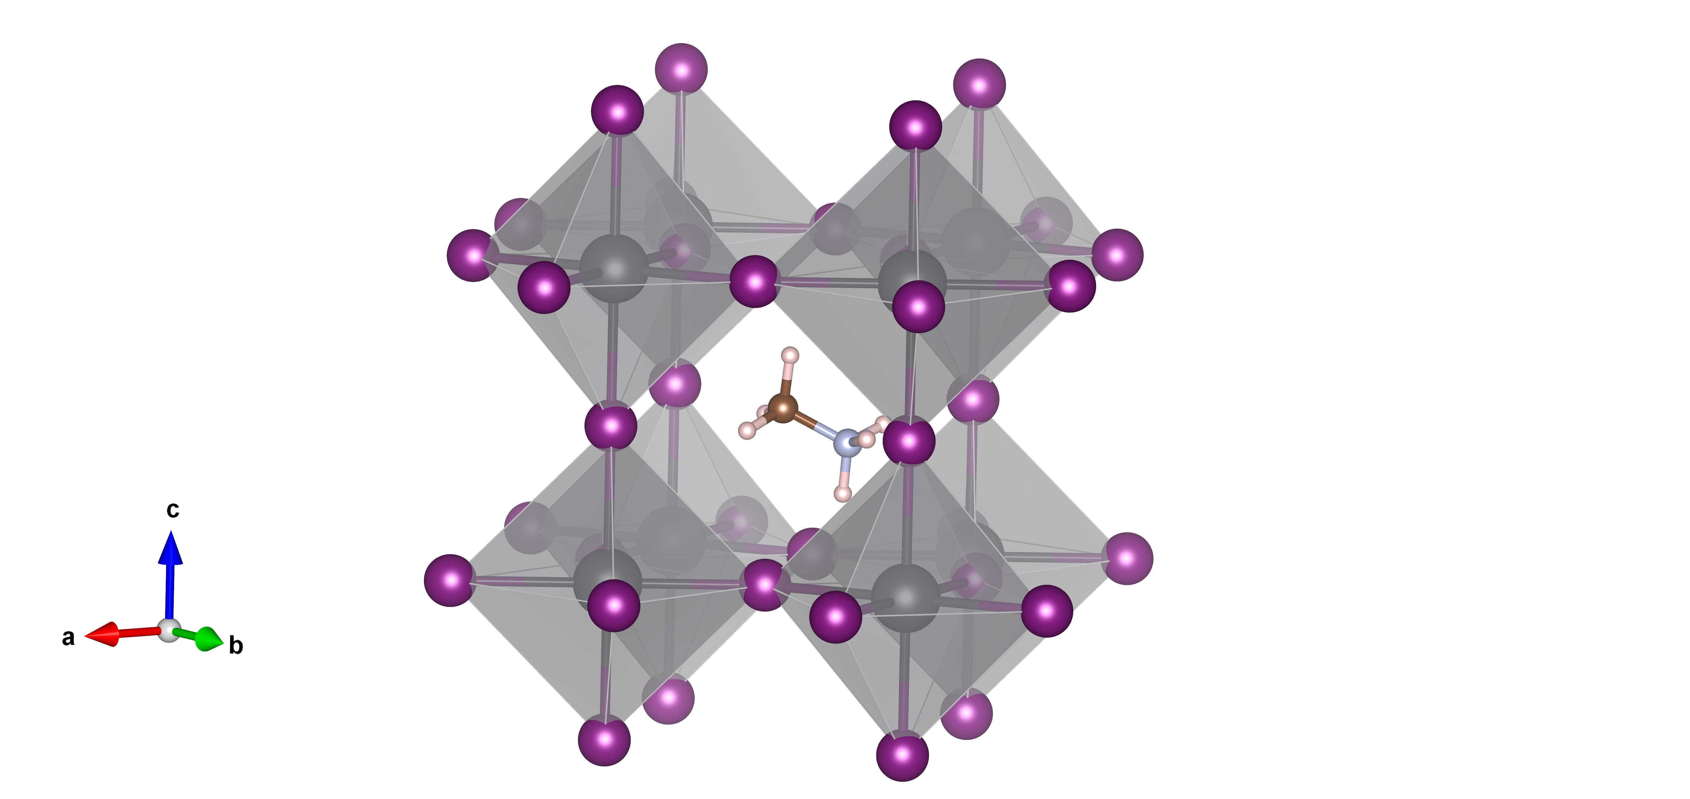
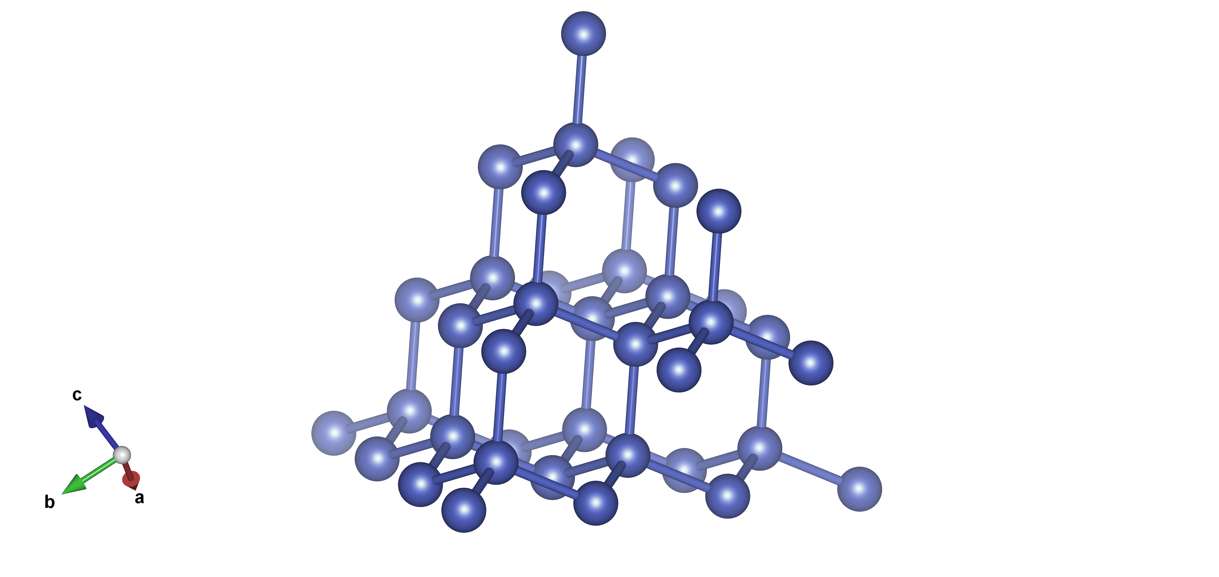
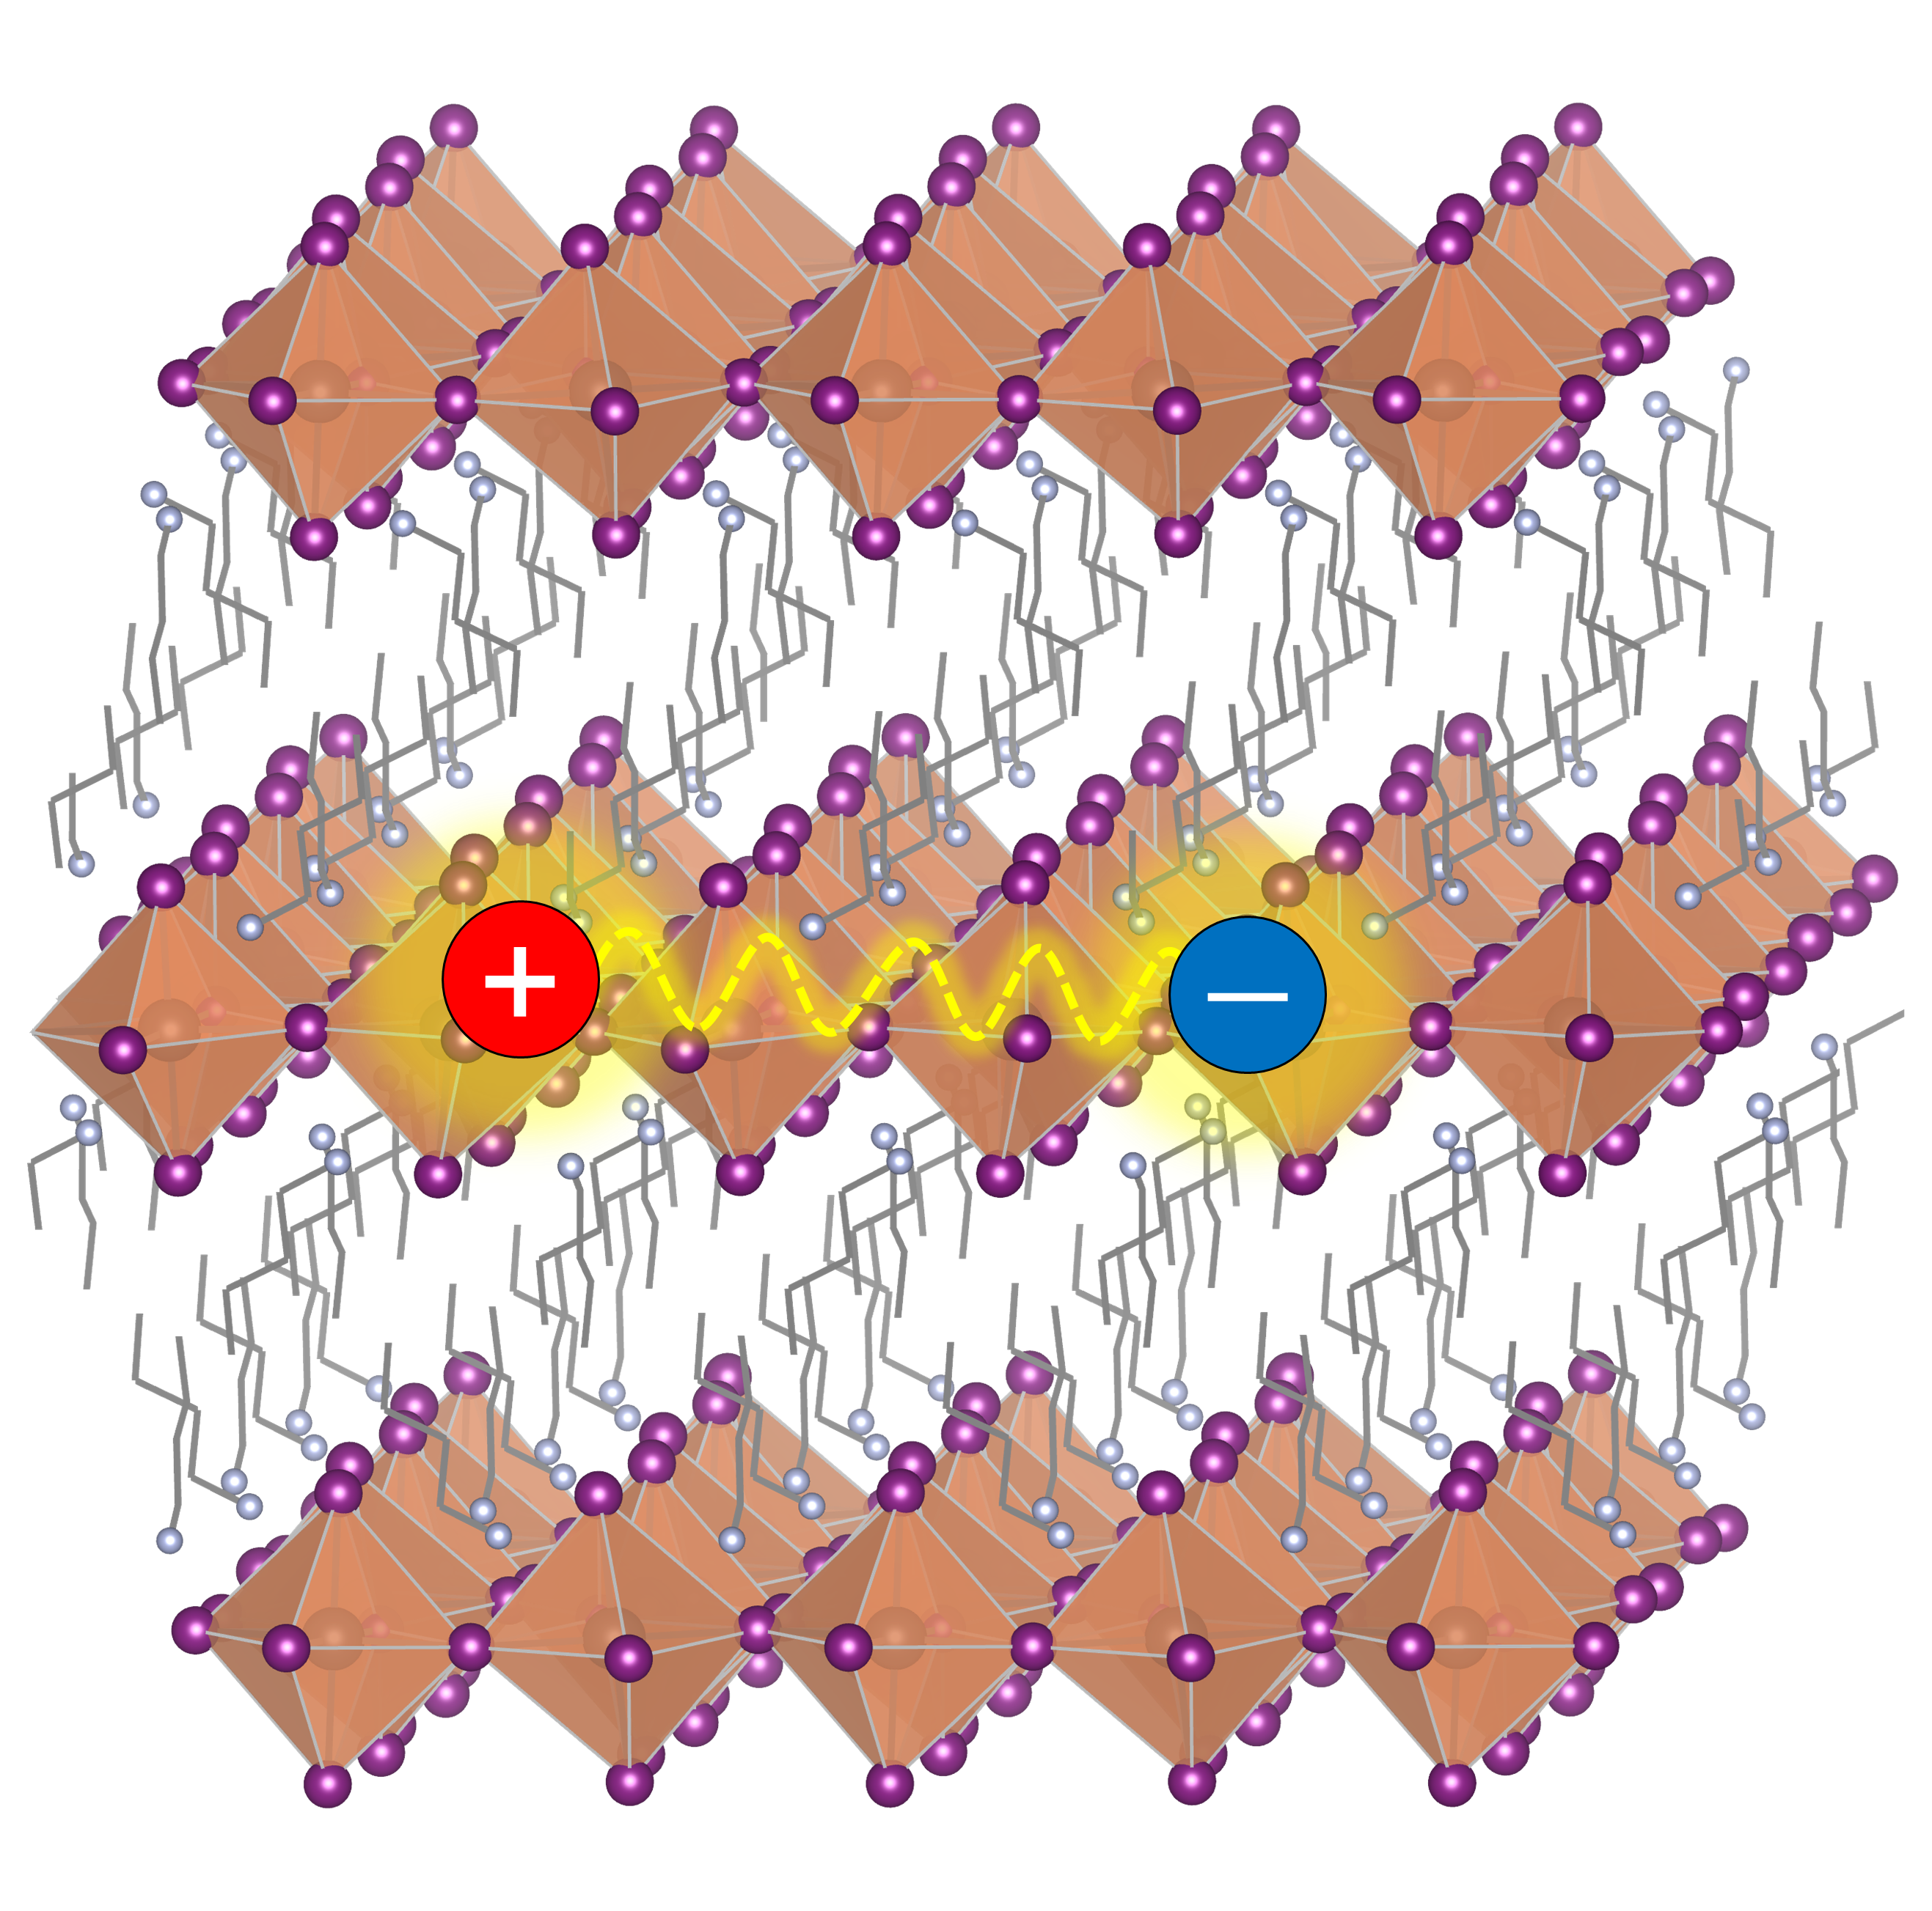
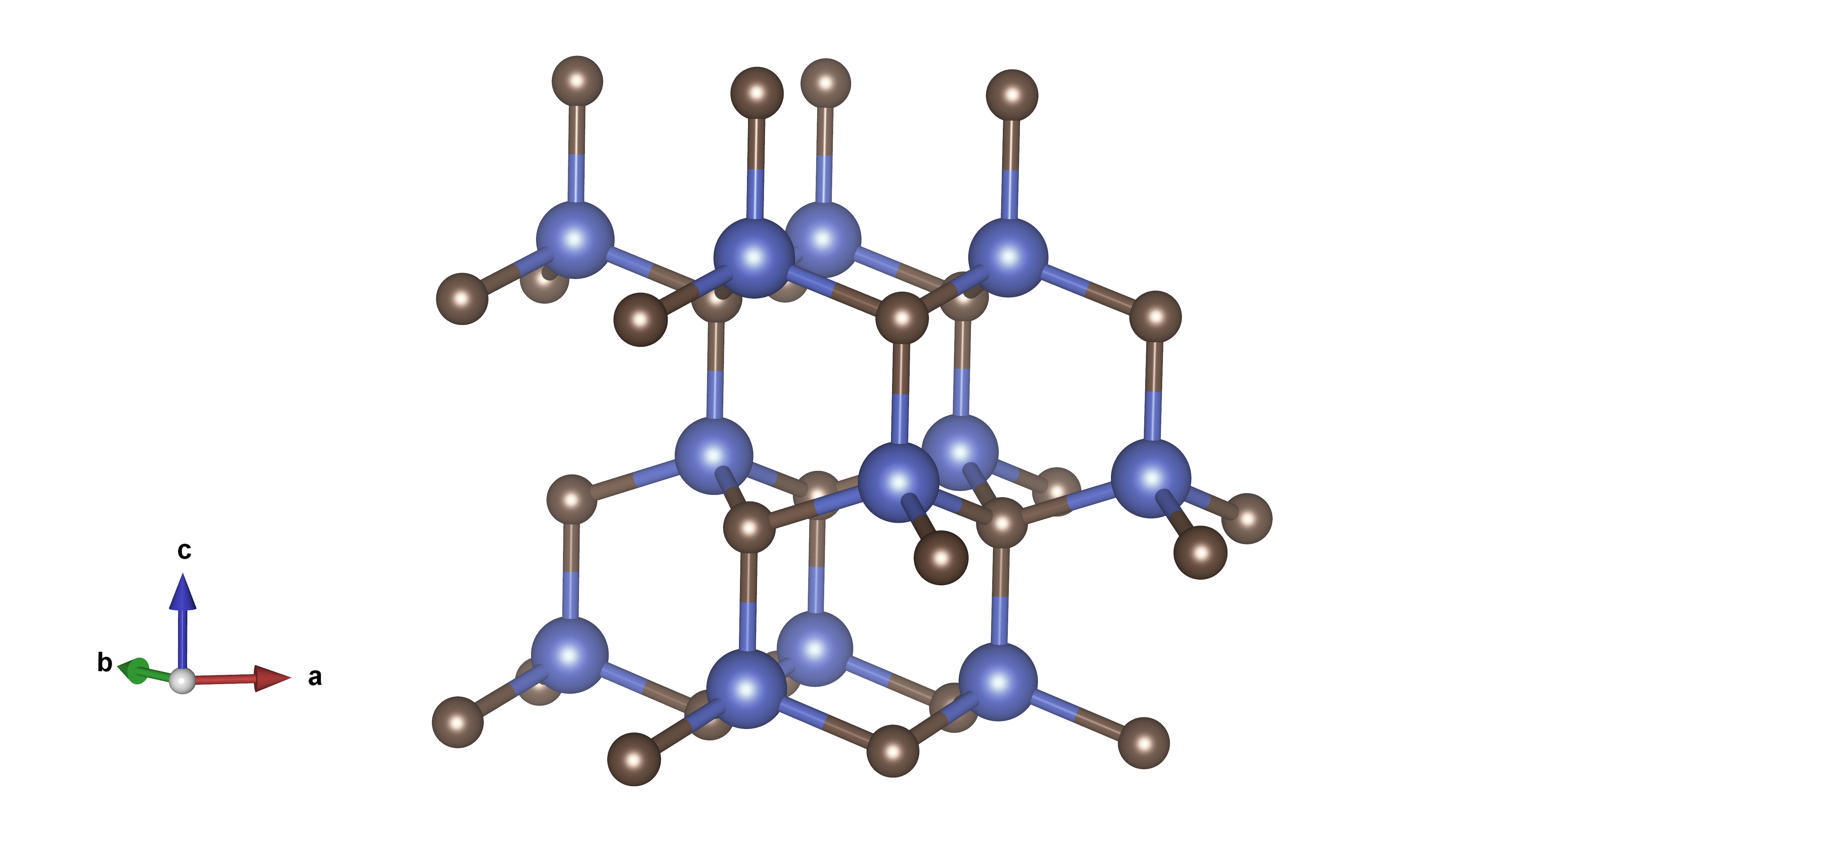
1.1 Why 2D Halide Perovskite?
aaa
GaAs
3D Perovskite
Si
SiC
2D Perovskite
Inorganic Semiconductors:
- Rigid;
- Static;
- Harmonic lattice;
Hybrid Halide Perovskites:
- Soft;
- Dynamic;
- Strong anharmonicity;
Well-Studied
New Properties of Anharmonic SCs?

Slide 4
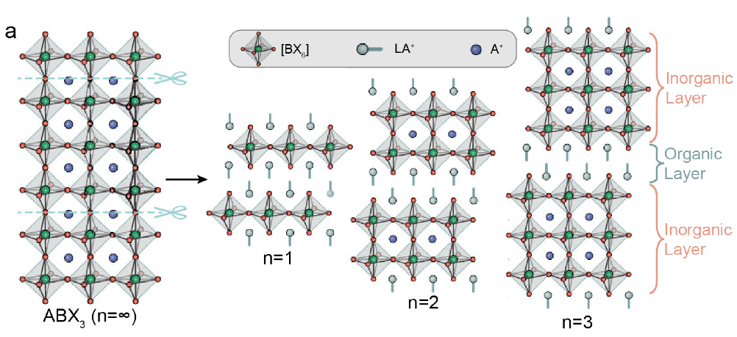
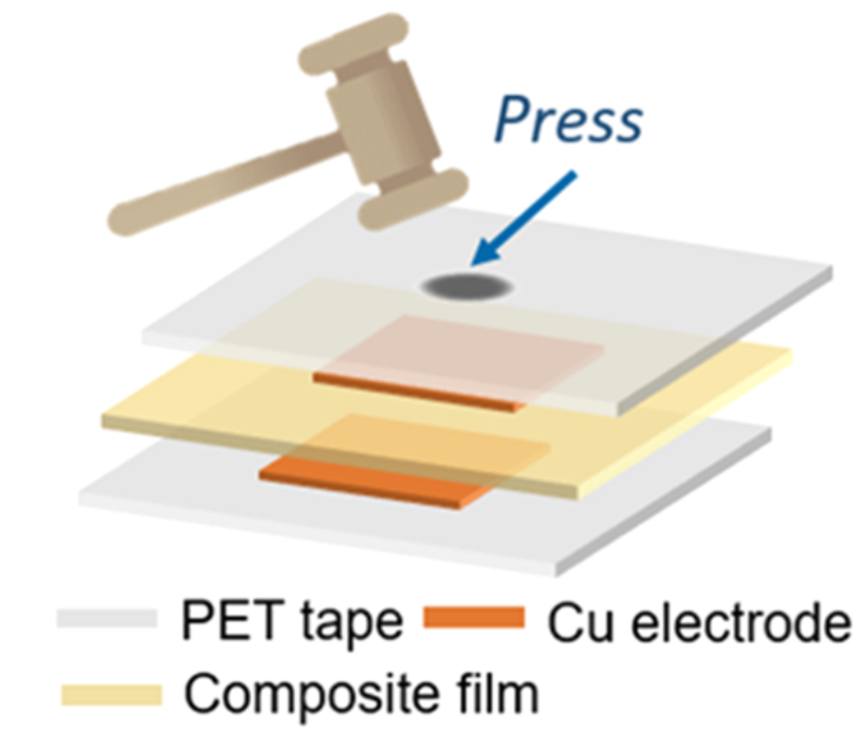
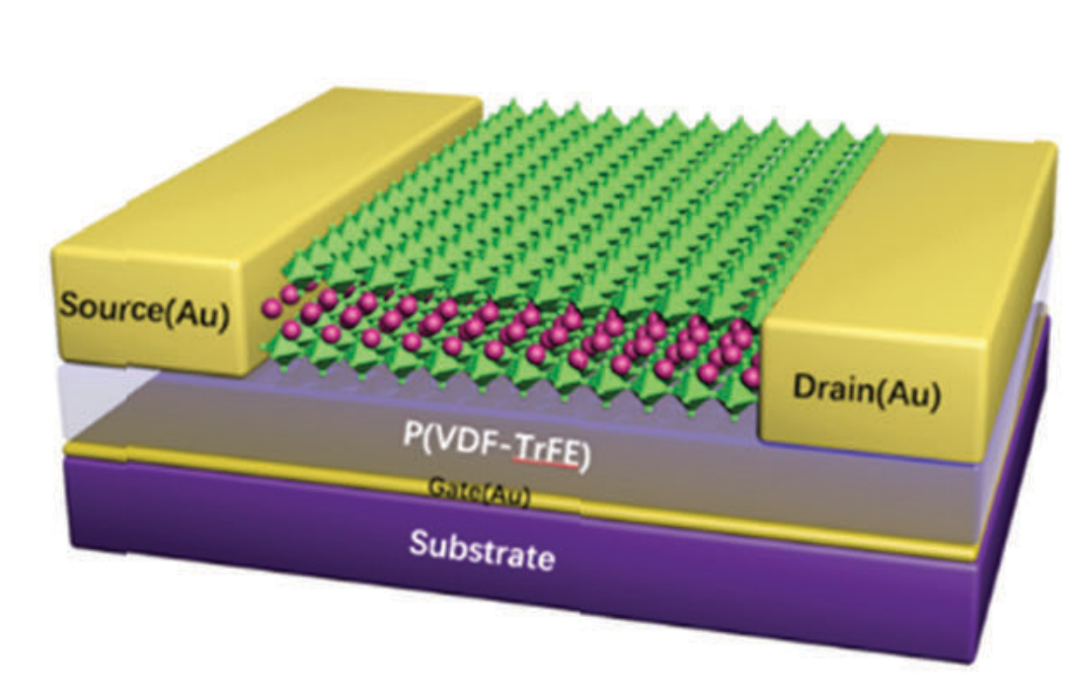
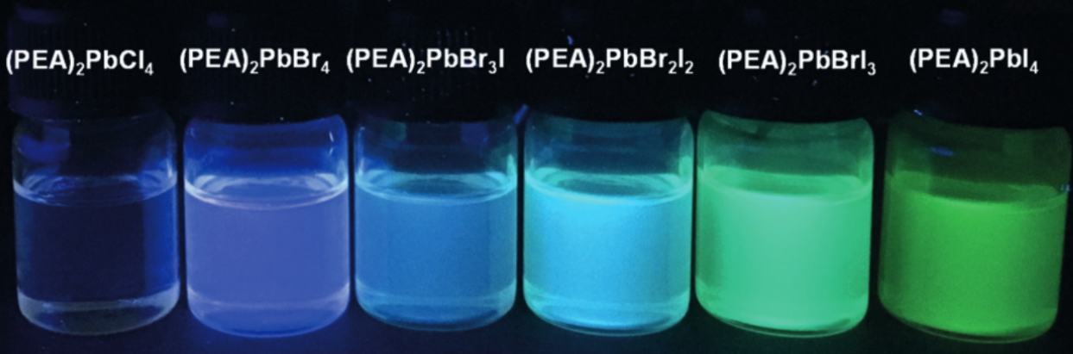
1.2 2D Halide Perovskites
Formula
(LA)₂(A)_{n-1}B_{n}X_{3n+1}
for n=1:
(LA)₂BX₄ (B²⁺ = Pb²⁺, Sn²⁺, Ge²⁺...)
Crystal Structure
"Slicing 3D perovskite ABX₃ lattice"
Various LA ==> Great tunability
Heterogeneity ==> Nano-devices
Layered structure ==> Excitonic nature
Ferroelectrics
Nanoelectronics
Light-emitters
Nat. Rev. Chem. 2021, 5, 838. Angew. Chem. Int. Ed. 2017, 56, 4252. ACS Nano 2022, 16, 2, 3221. J. Mater. Chem. C, 2018, 6, 12714
Notes:
title explain

Slide 5
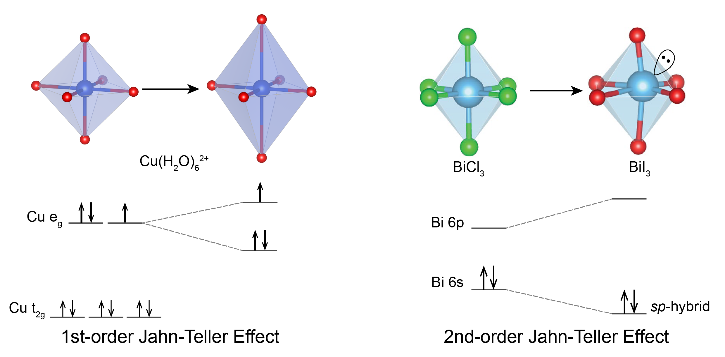
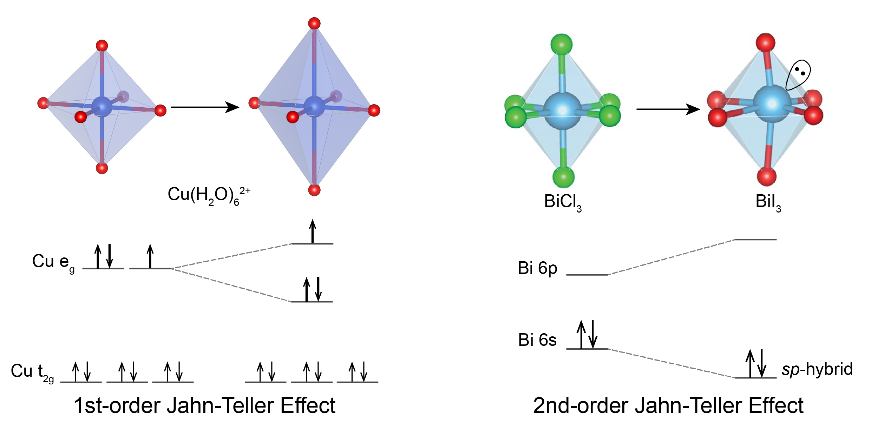
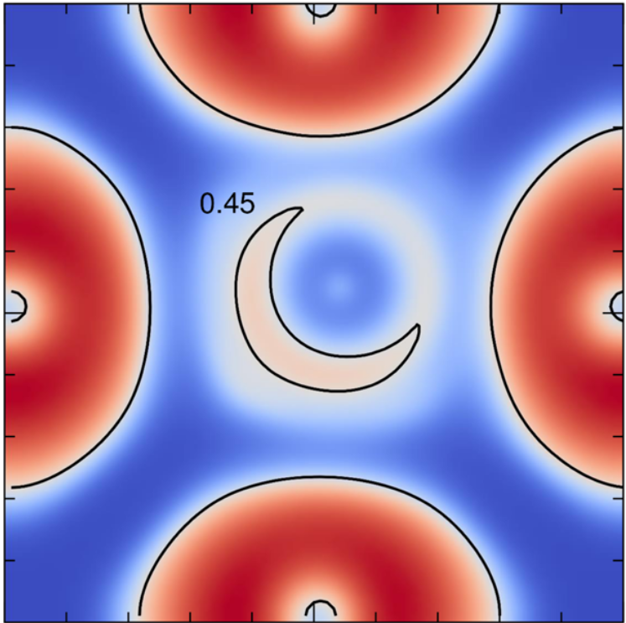
1.3 ns² Lone Pair Effect (LPE)
Second-order Jahn-Teller (SOJT) Effect
.
ns² lone pair effect &
off-center displacement
Nat. Rev. Chem. 2021, 5, 838. JACS, 2016, 138, 11820.
Notes:
focus on excited state potential surface & properties
remove t2g right

Slide 6
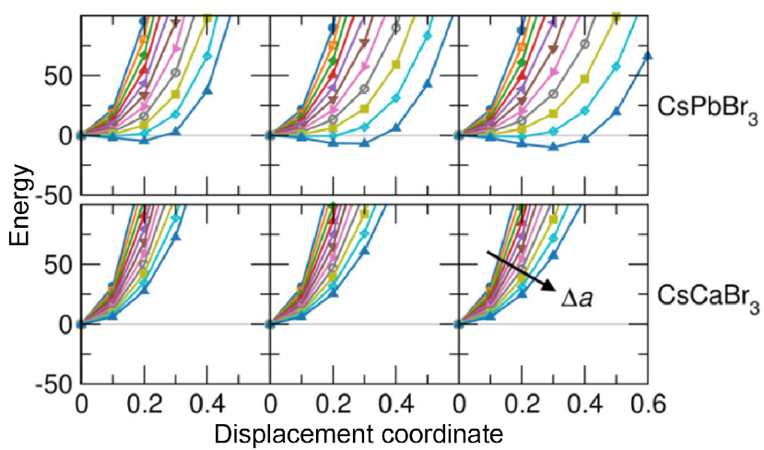
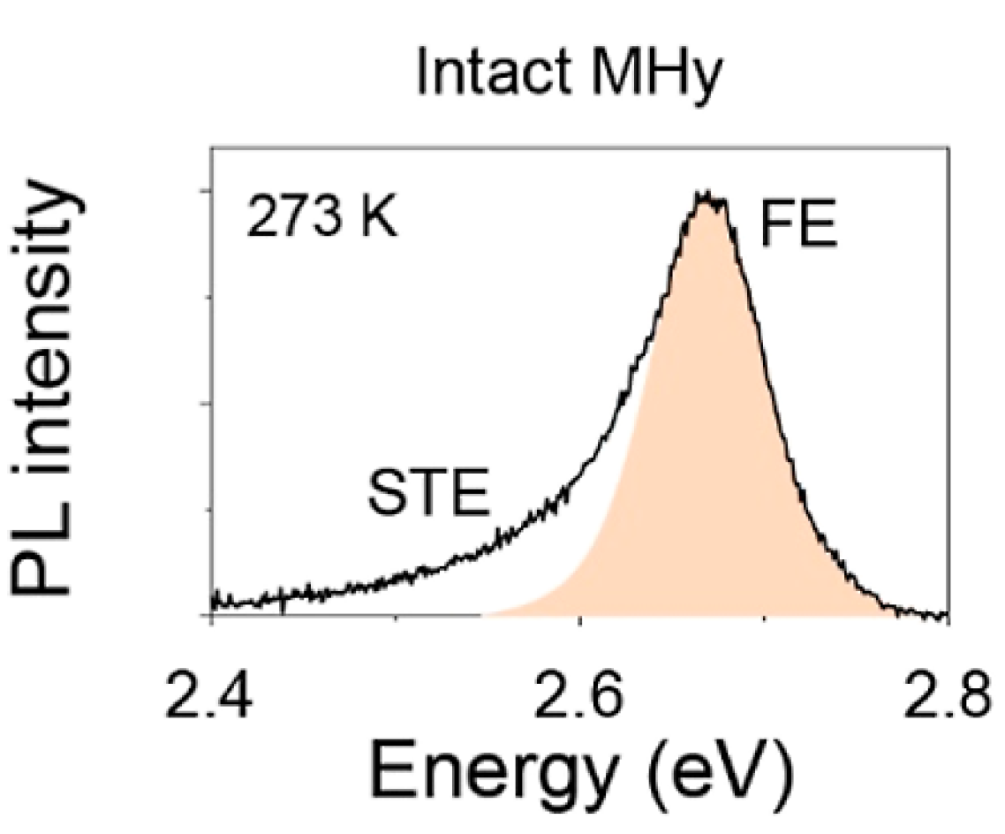
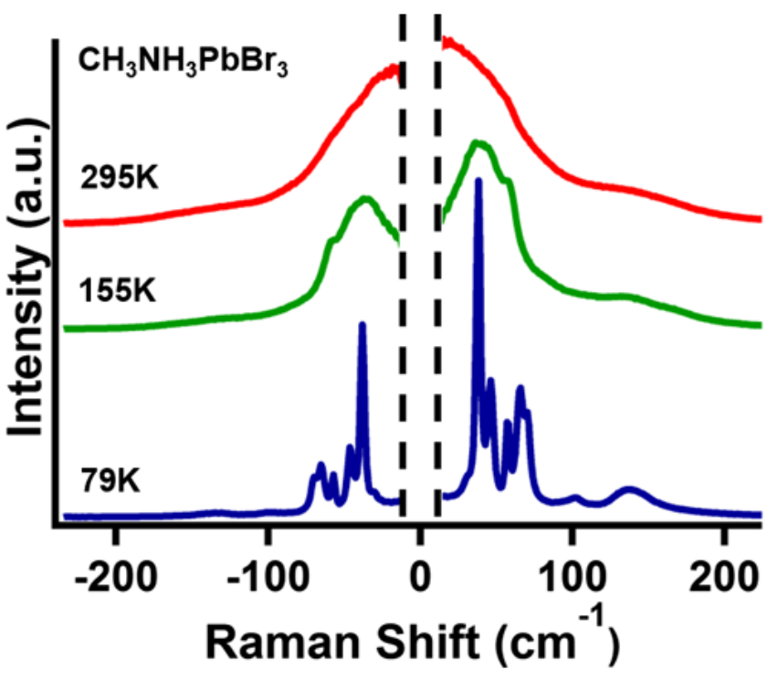
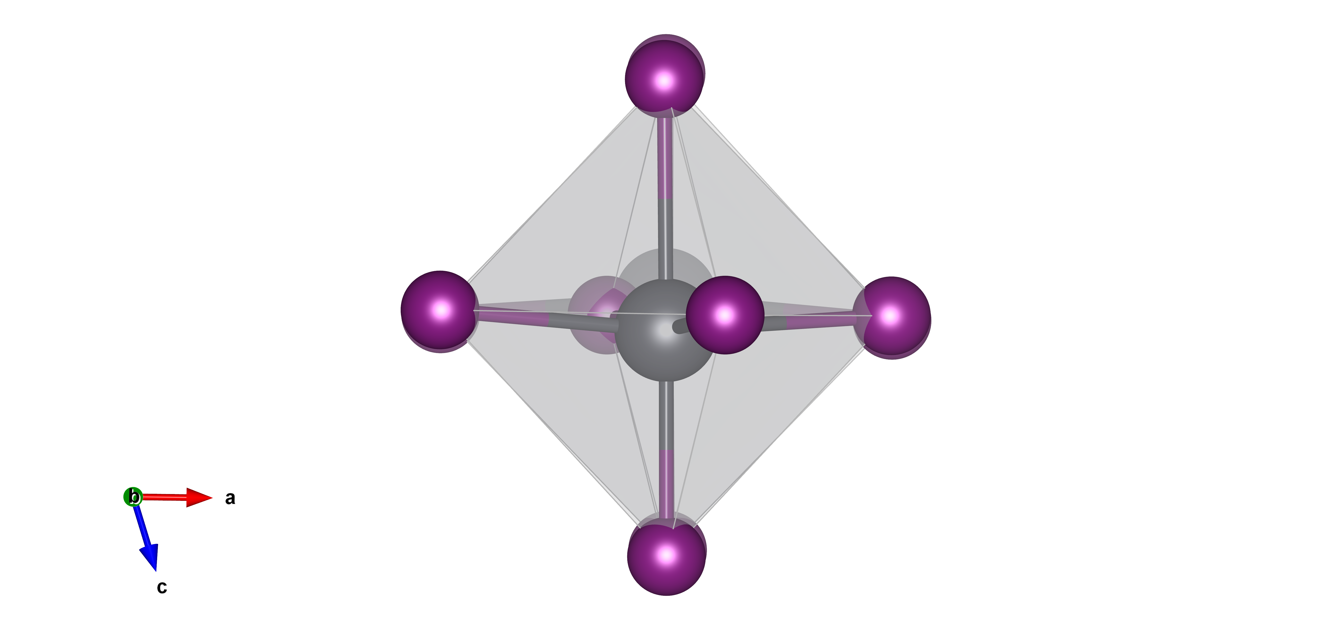
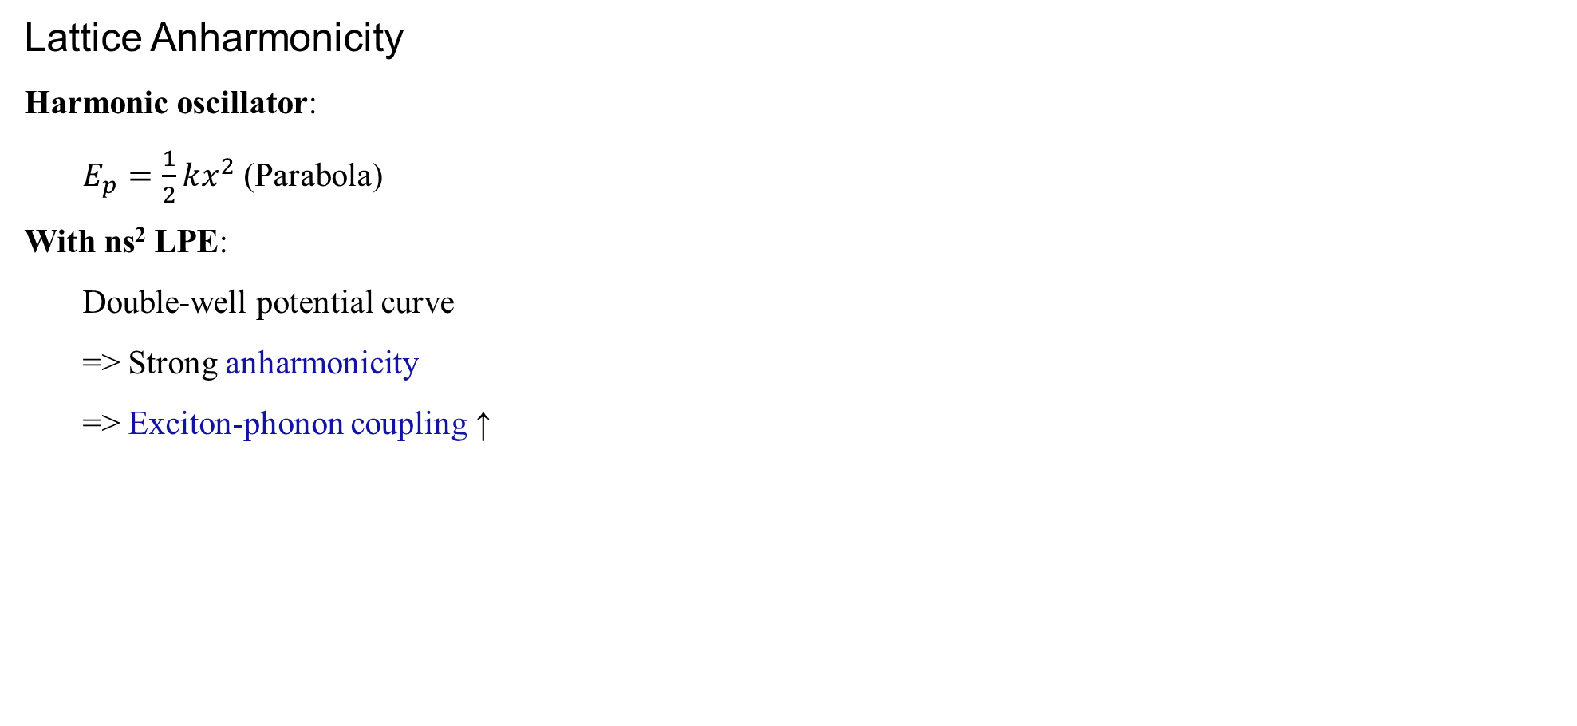
1.3 ns² Lone Pair Effect (LPE)
Lattice Anharmonicity
Lattice Anharmonicity
Harmonic oscillator:
$E_{p}=\frac{1}{2}kx^{2}$ (Parabola)
With ns² LPE:
Double-well potential curve
=> Strong anharmonicity
=> Exciton-phonon coupling ↑
([Xe]6s²)
([Ar])
Exciton-Phonon Coupling
Pb²⁺ 6s² LPE
Nat. Rev. Chem. 2021, 5, 838. JACS, 2016, 138, 11820. Phys. Rev. Lett. 2017, 118, 136001. JACS. 2022, 144, 27, 12247
Notes:
LPE enhances EPC.
Give Examples.

Slide 7
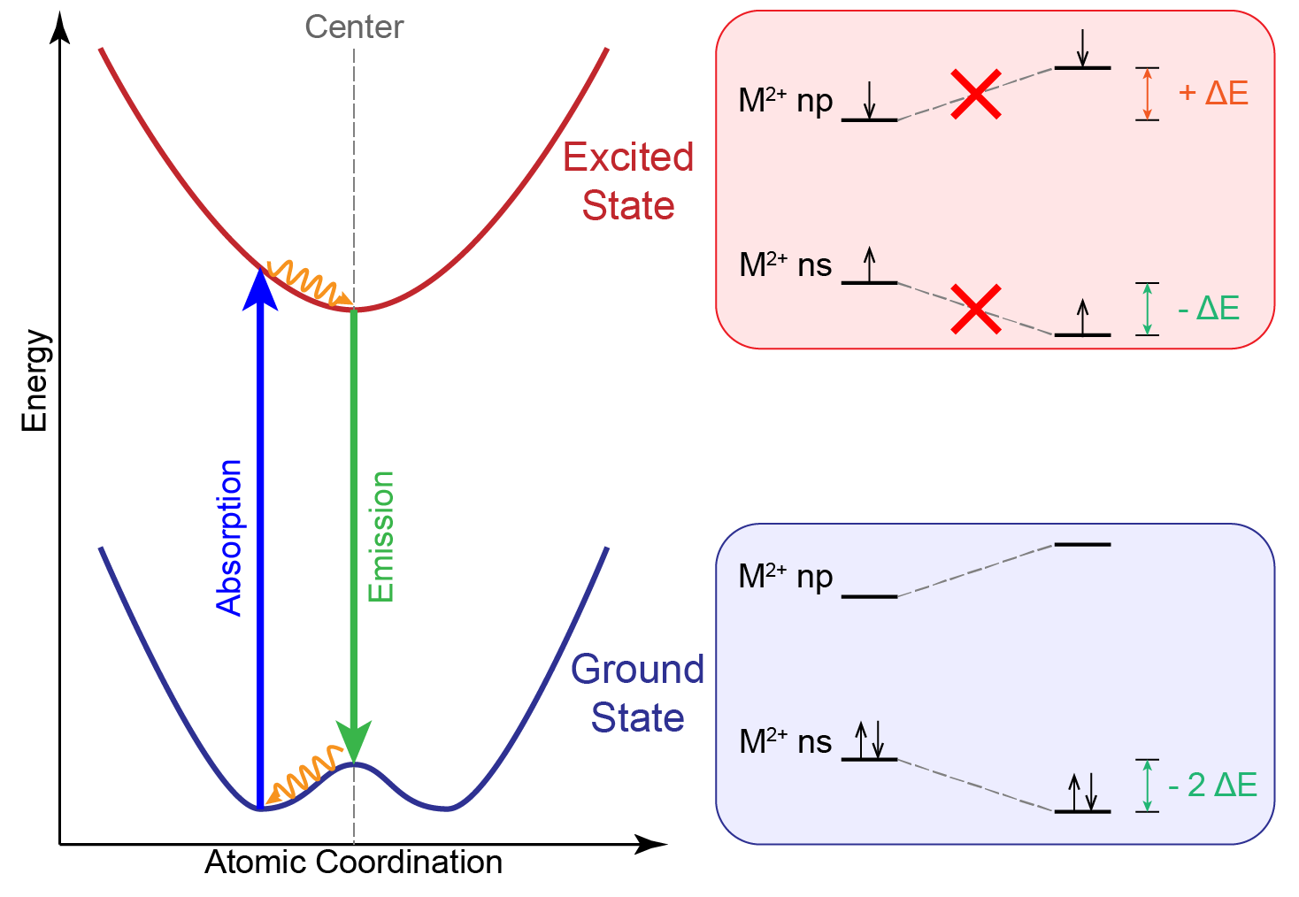
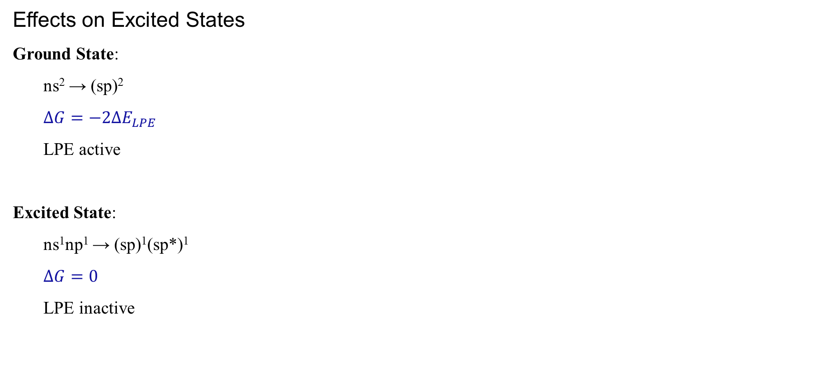
1.3 ns² Lone Pair Effect (LPE)
Effects on Excited States
Ground State:
ns² → (sp)²
$ΔG=−2ΔE_{LPE}$
LPE active
Excited State:
ns¹np¹ → (sp)¹(sp*)¹
$ΔG=0$
LPE inactive
LPE enhances exciton-phonon coupling.
Notes:
LPE changes excited state properties.
- vanish of LPE in excited state;
- Hot carriers relaxation(?)
- Coherent phonons (but no articles in this topic!)

Slide 8
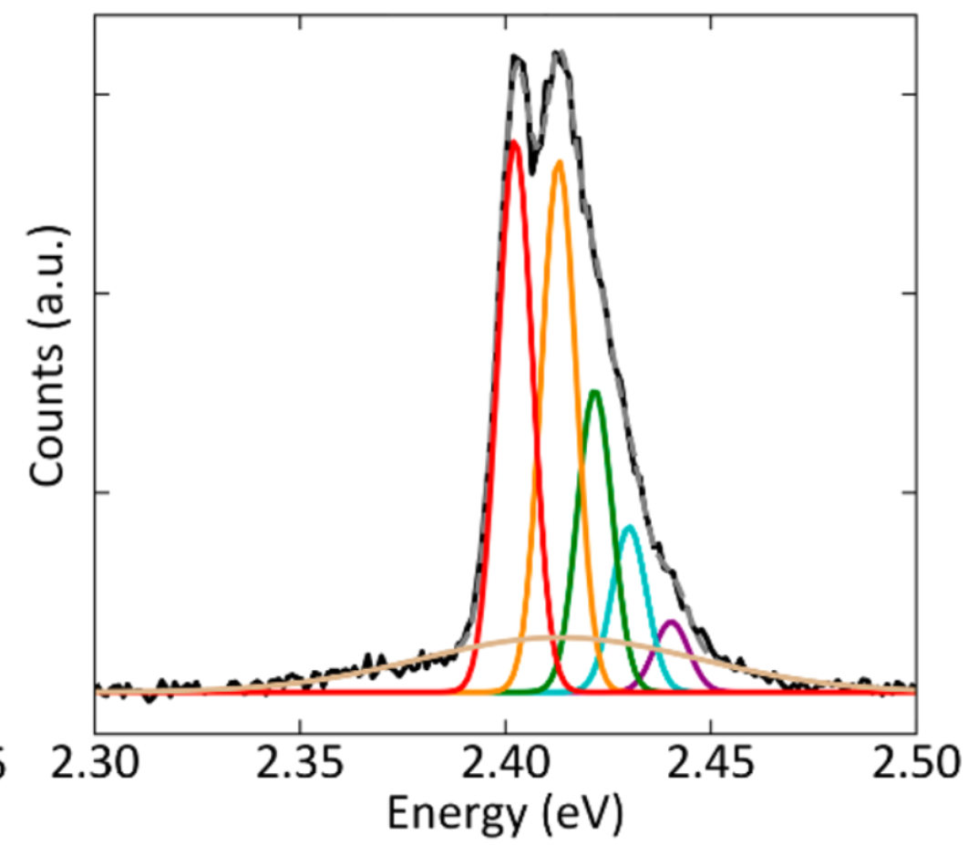
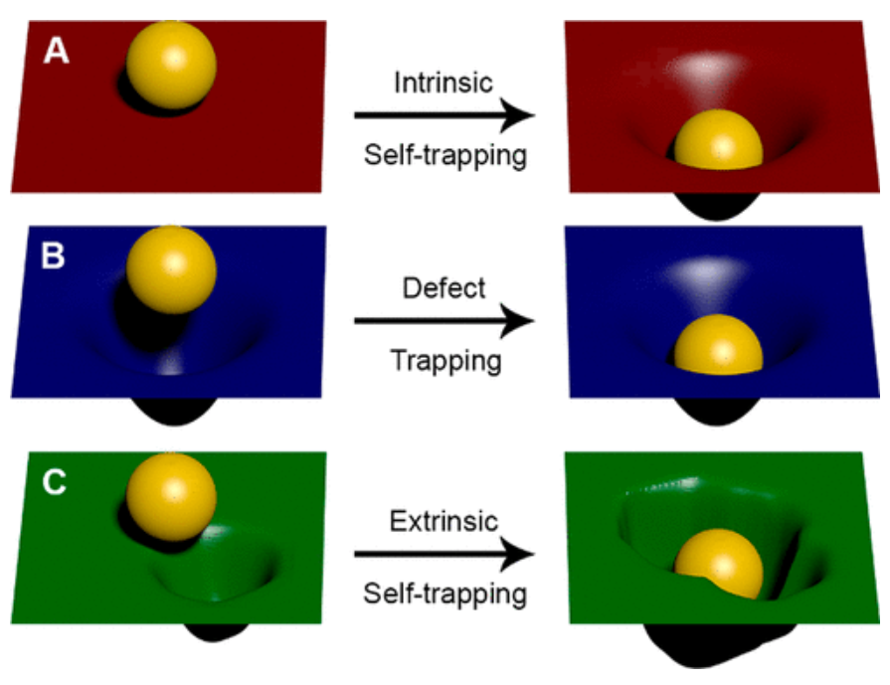
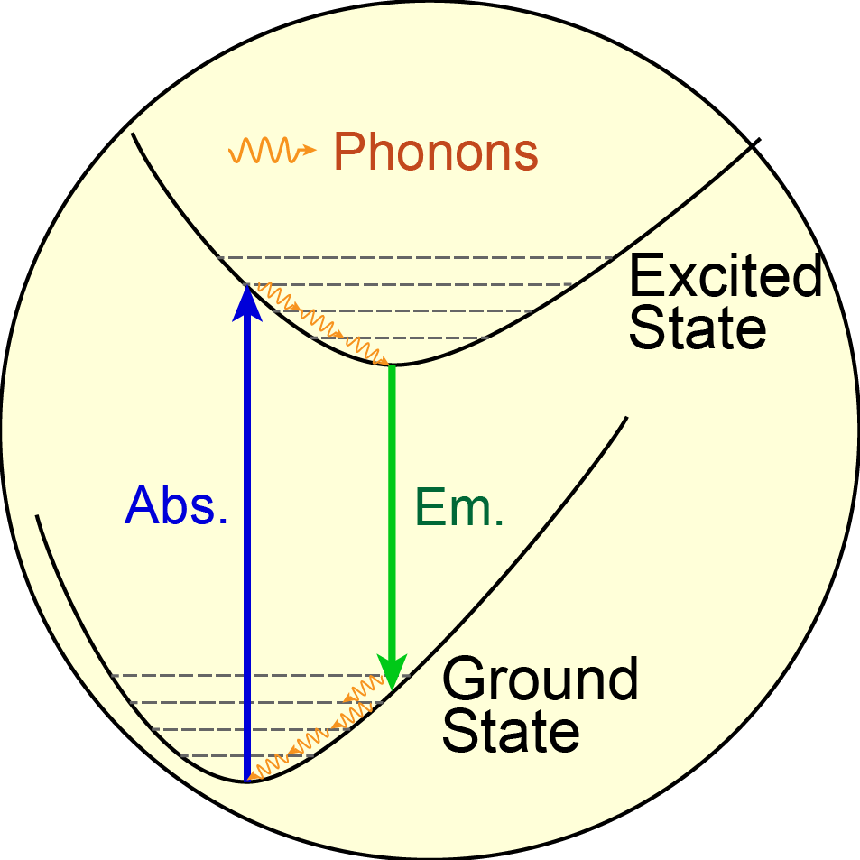
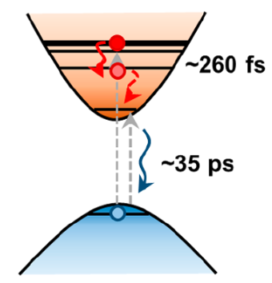
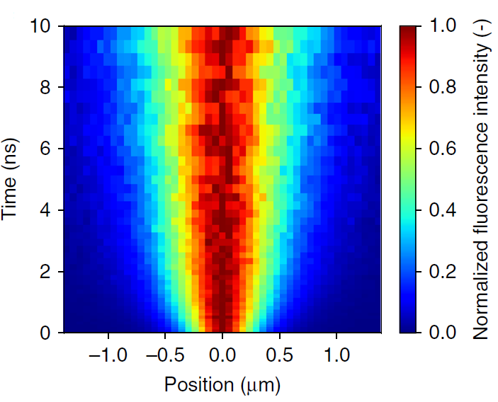
1.4 Exciton-Phonon Coupling (EPC)
Emission Spectrum
Carrier
Self-Trapping
Excited State Dynamics
Exciton Transport
ACS Nano 2020, 14, 3, 3621. Acc. Chem. Res. 2018, 51, 3, 619. Nat. Comm. 2020, 11, 2035. ACS Nano 2019, 13, 11, 12621–12629
Notes:
Researches on EPC tuning Photophysics, examples;
Change figure to F-C curves
What is EPC;
What photophysics does it influence (Examples)

Slide 9
1.5 Research Overview
Light Emission
Exciton
Diffusivity
?
ns² Lone Pair
Effect
Photophysical Properties
Influence?
Mechanism?
Structure-property Relationship?
......
Coherent Phonons

Slide 10
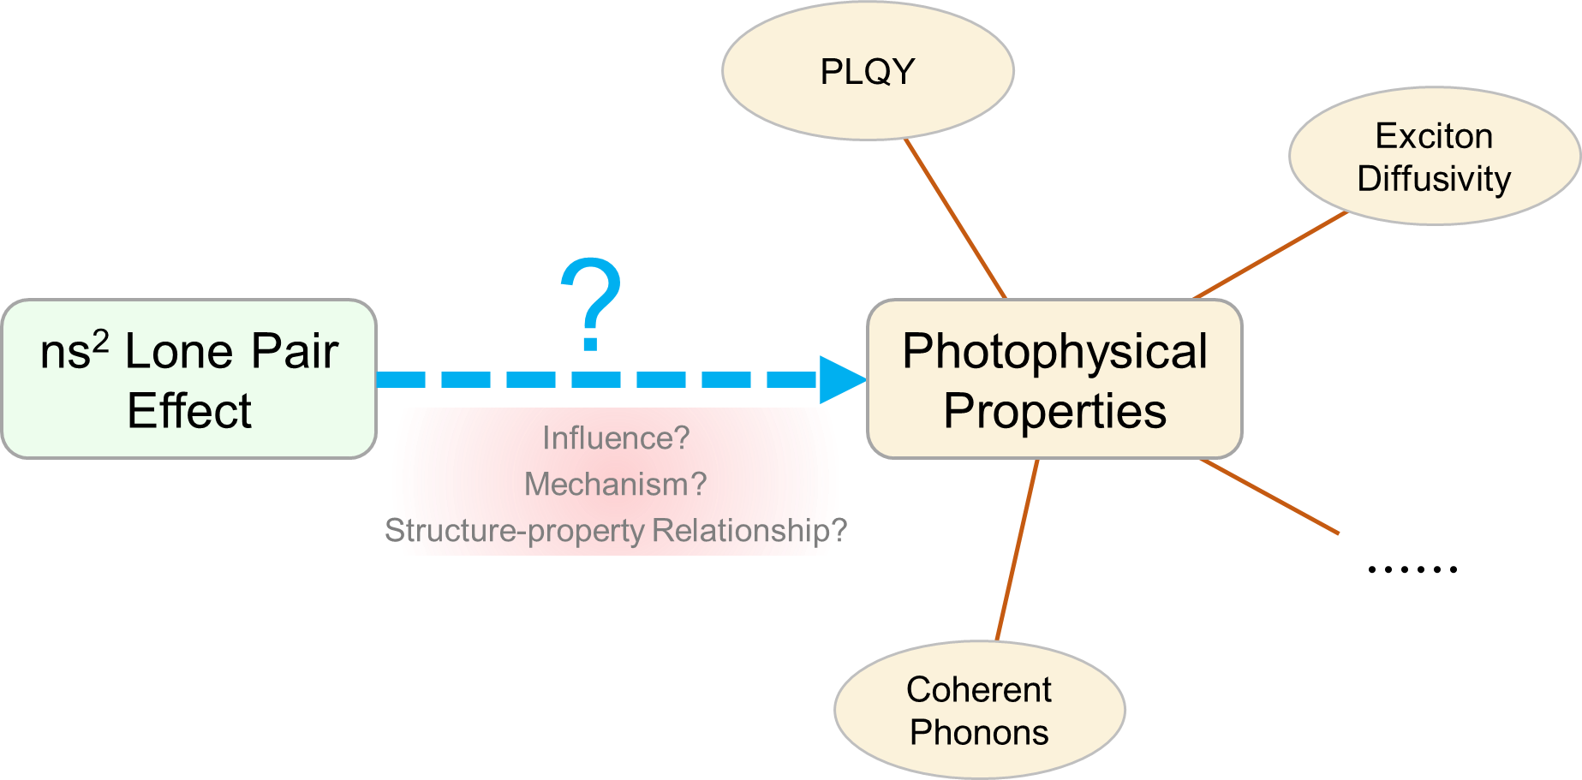
1.5 Research Overview
Part. 1: Origin of ns² LPE & tuning PLQY (Done)
- Large LA elongates Pb-I bond length and induces ns² LPE;
- ns² LPE enhances EPC and quenches PL;
Part. 2: ns² LPE tuning exciton diffusivity (On-going)
- ns² LPE enhances exciton scattering;
- Strong LPE will decrease exciton diffusivity (expected)
Part. 3: Excited-state properties upon ns² LPE phase transition (Scheduled)
- Use coherent phonon spectrum to evaluate EPC upon LPE transition.

Slide 11
Part. 2
Current Progress
LPE tuning structural distortion
LPE tuning PLQY
LPE tuning exciton diffusivity

Slide 12
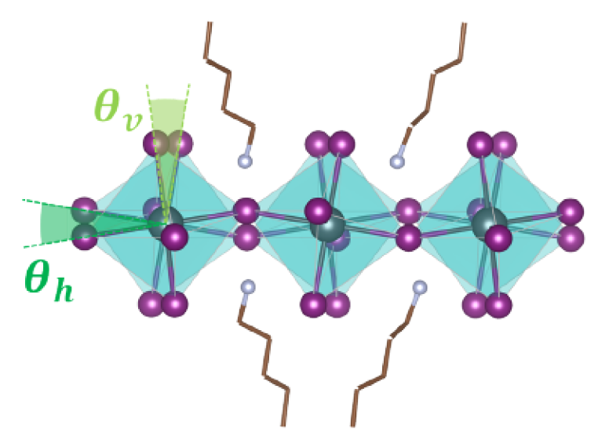
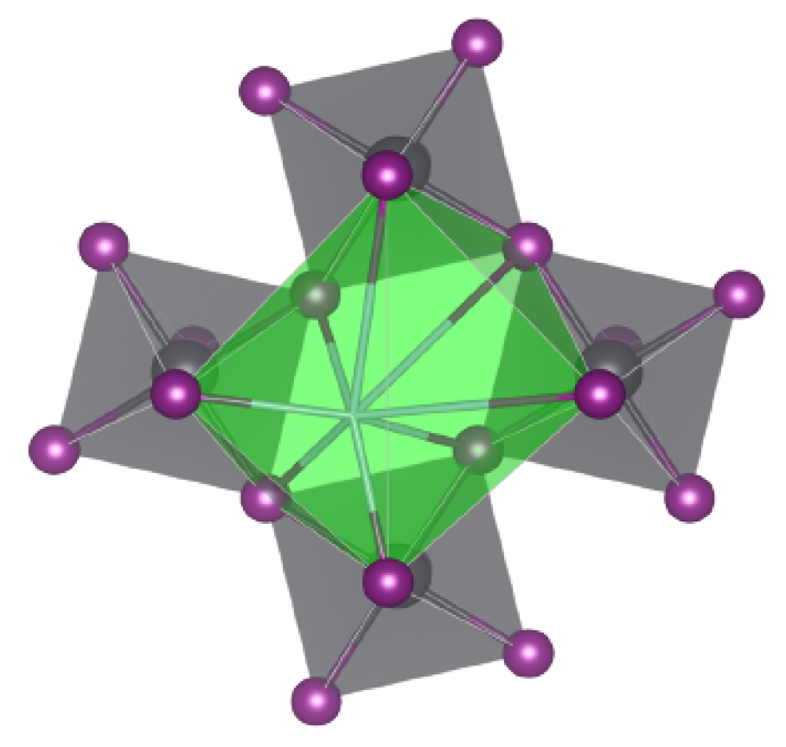
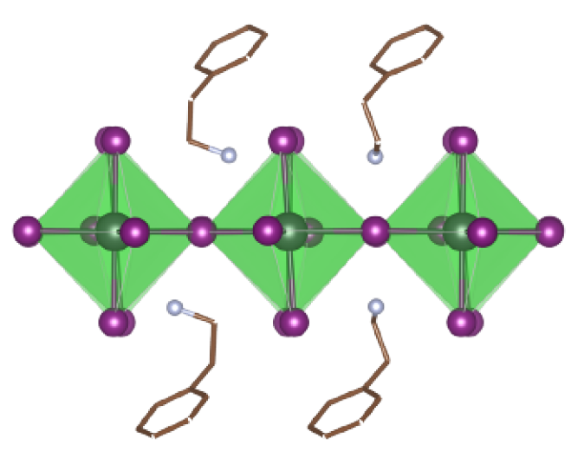
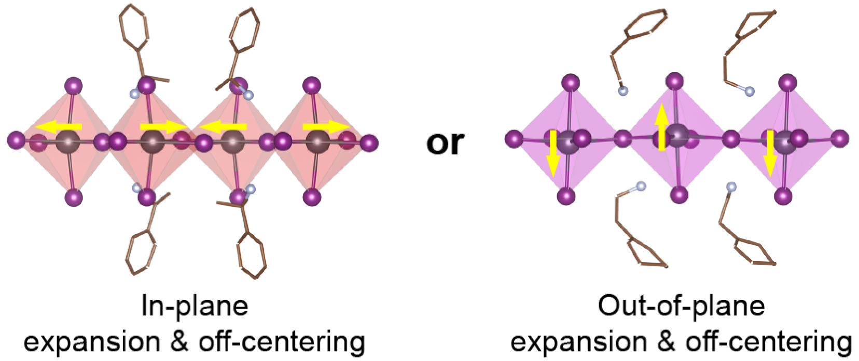
2.1 Origin of ns² LPE
V_{eff} = 97.7 A³
Undersized LA
Octahedral tilting
LA Size
- Undersized LA --> Octahedral tilting
- Oversized LA ----> Pb off-centering
Off-centering Heterogeneity
R-MBA: in-plane off-centered
CHEA: out-of-plane off-centered
also validated in 18 other samples.
V_{eff} = 101.0 A³
Medium LA
Tiniest distortion
Effective volume
[NI₈]
V_{eff} = 108.9 A³
Oversized LA
Pb²⁺ off-centering
Angew. Chem. Int. Ed. 2023, 62, e202304515.

Slide 13
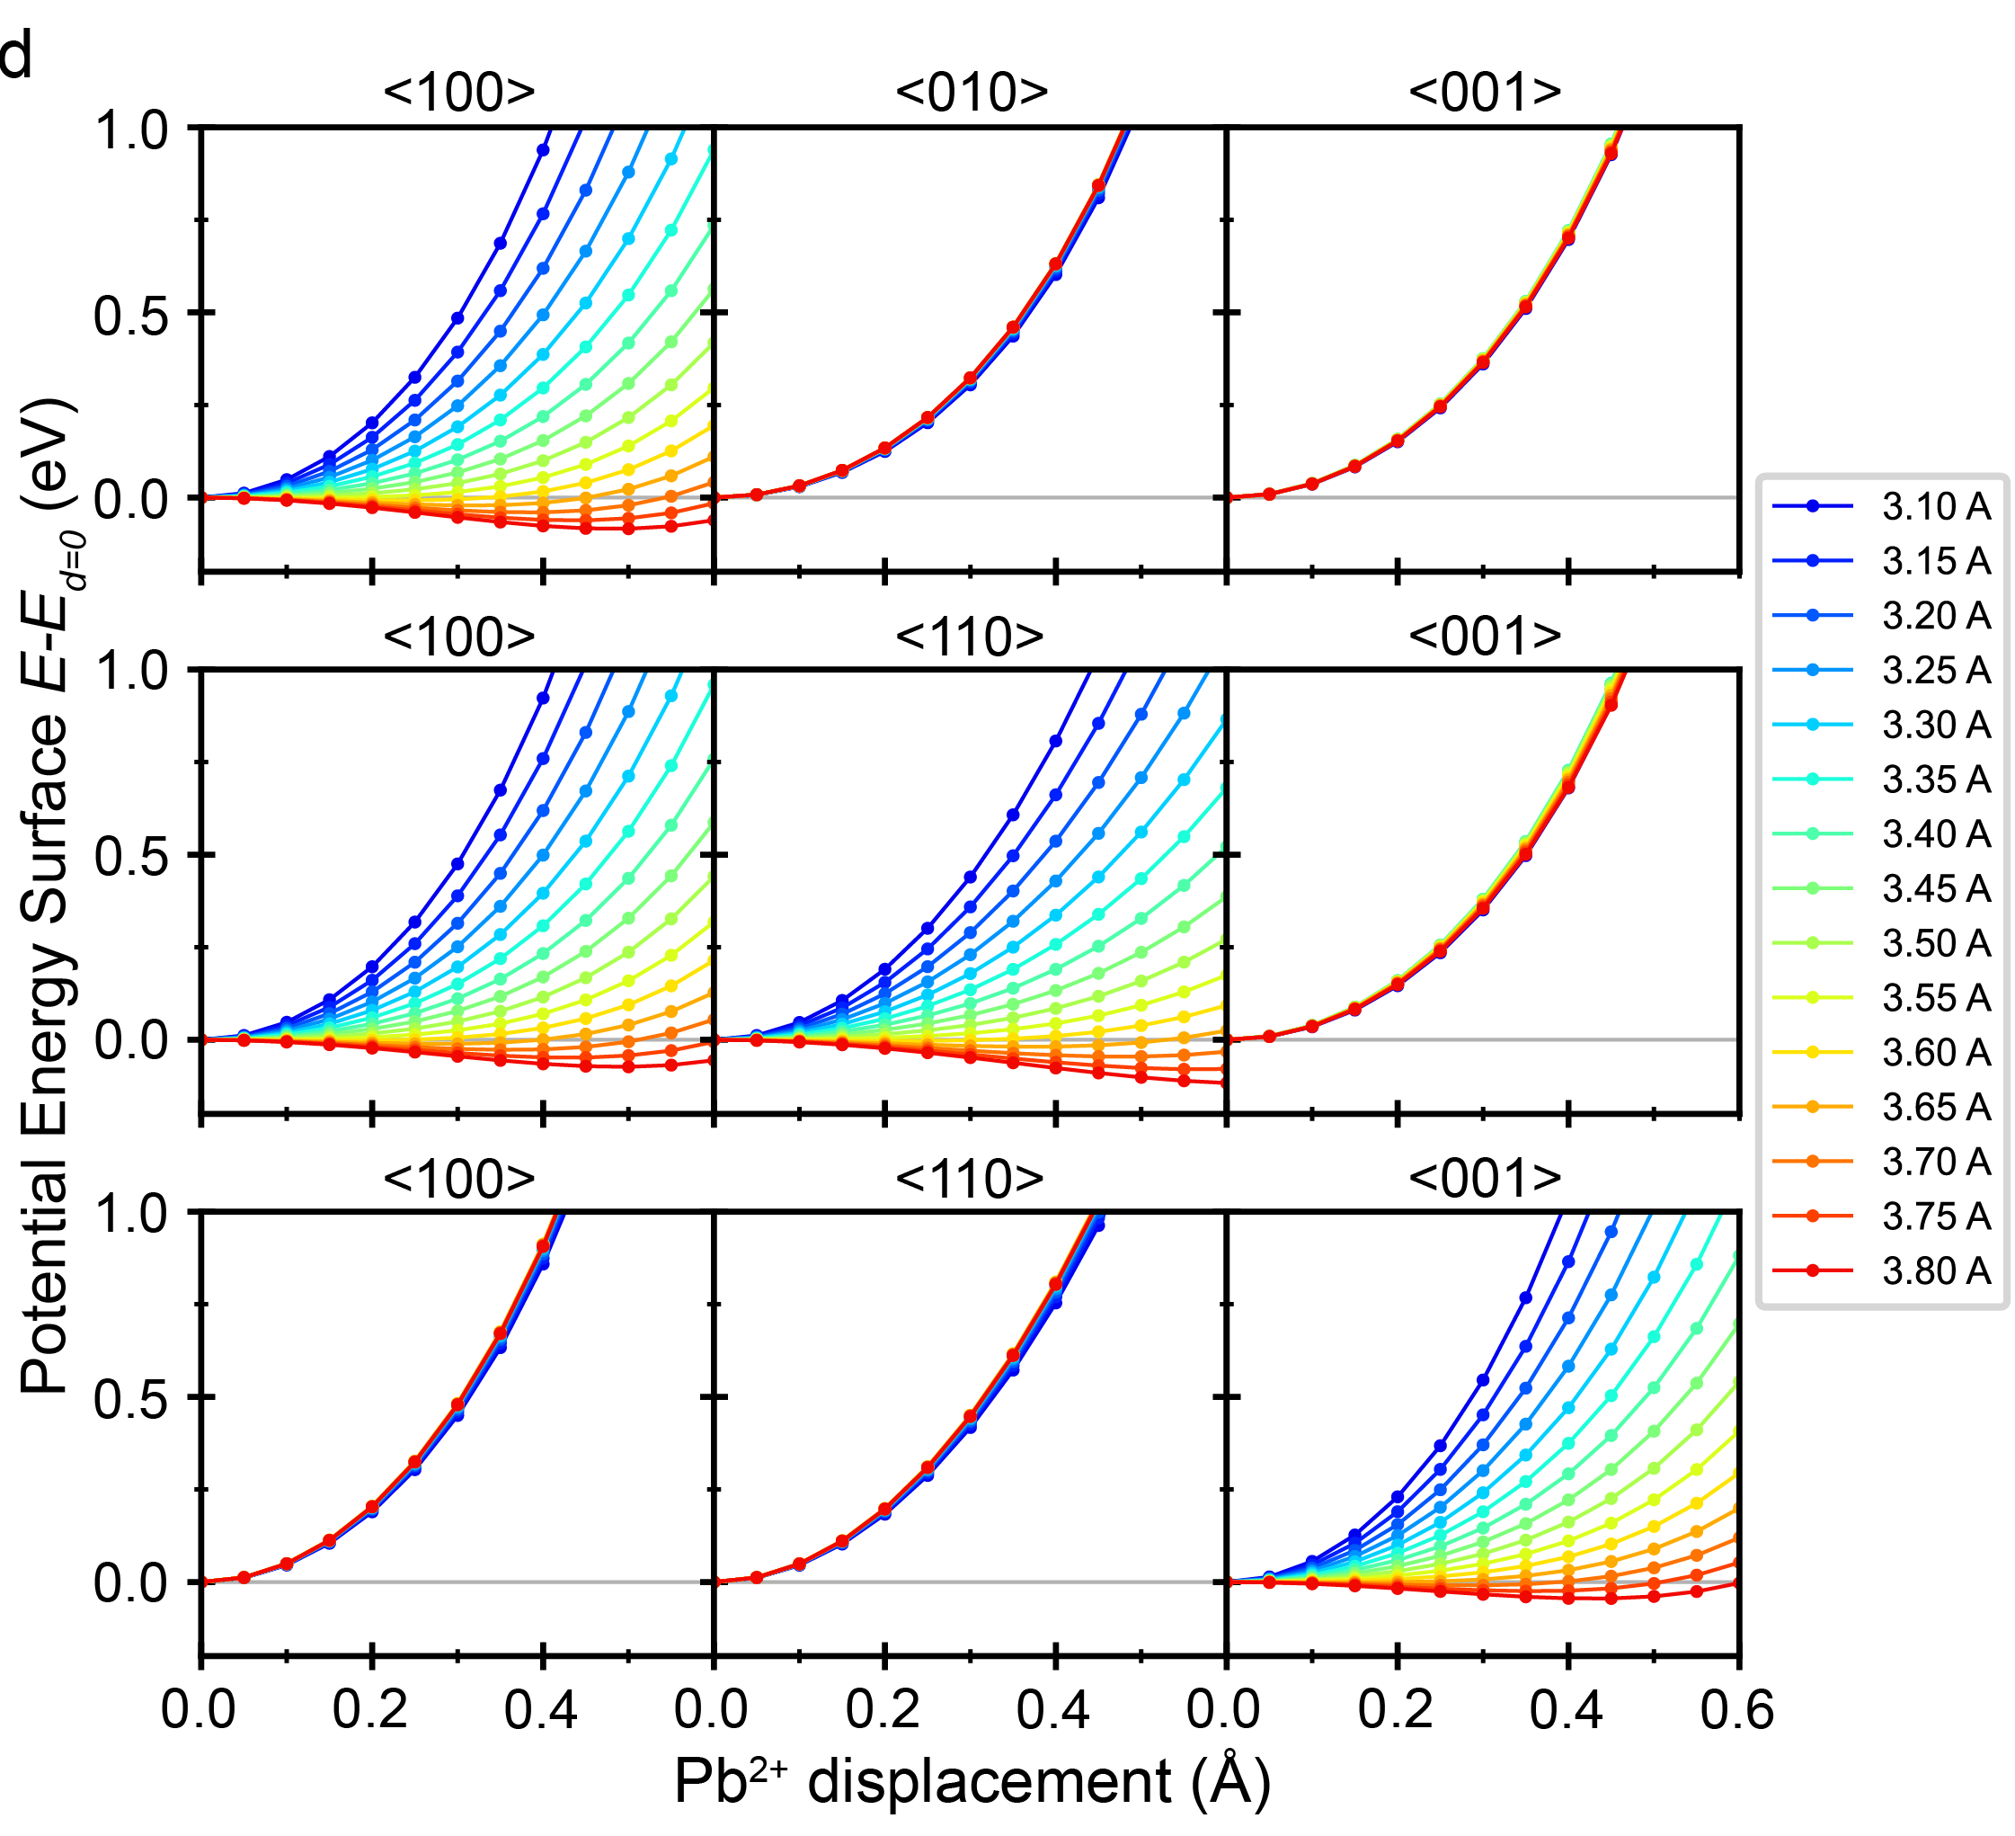
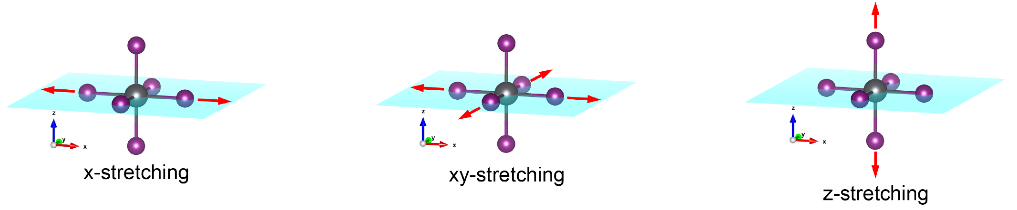
2.1 Origin of ns² LPE
DFT Calculation Results
Model: Cs₂PbI₄
Stretched Axis
Anharmonic Double-well
Unstretched Axis
Harmonic Parabola
Pb-I elongation induces 6s² LPE
Angew. Chem. Int. Ed. 2023, 62, e202304515.
Notes:
remove ELF
add stretch mode

Slide 14
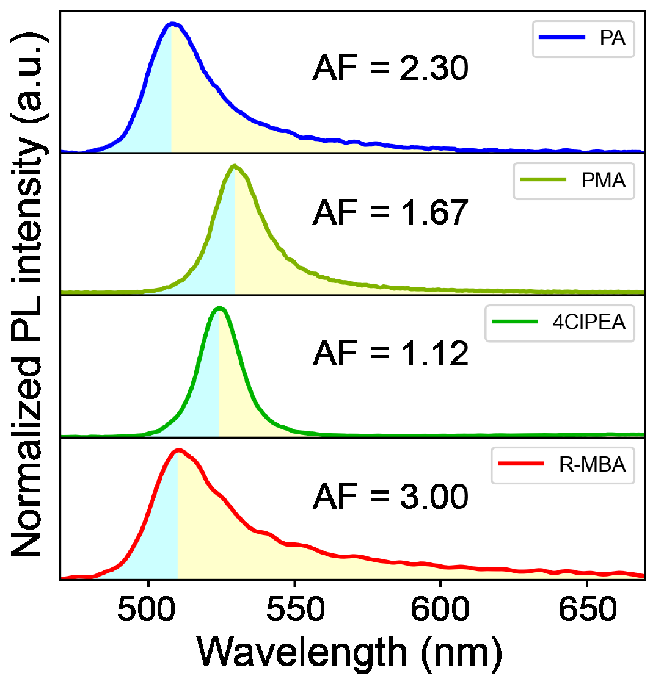
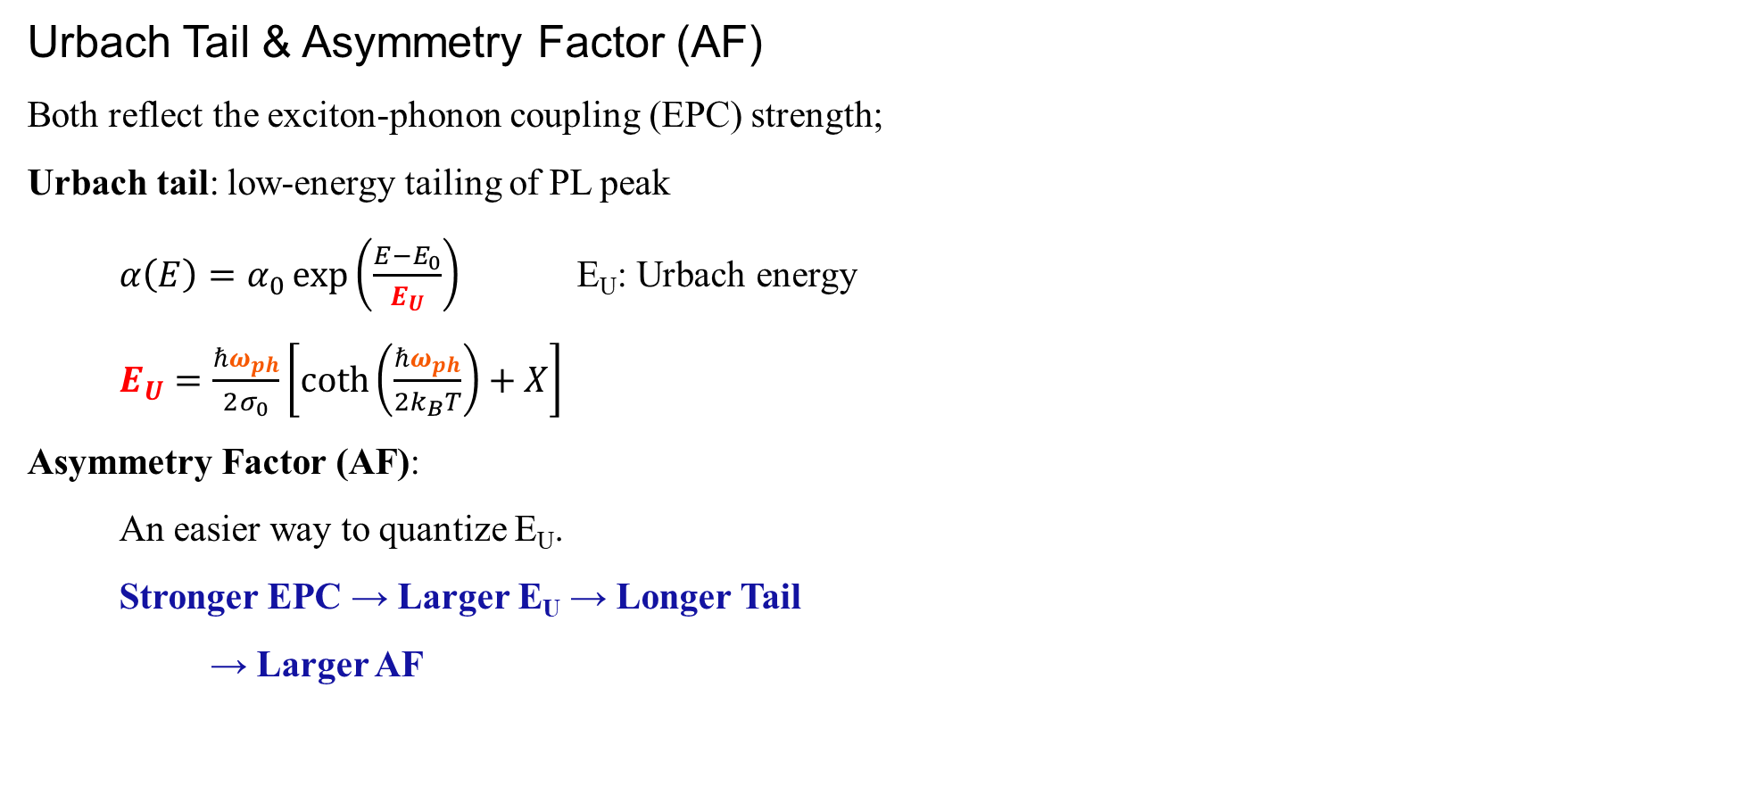
2.2 Correlating ns² LPE with PLQY
Urbach Tail & Asymmetry Factor (AF)
Both reflect the exciton-phonon coupling (EPC) strength;
Urbach tail: low-energy tailing of PL peak
$α\left(E\right)=α_{0}\exp\left(\frac{E−E_{0}}{E_{U}}\right)$ E_{U}: Urbach energy
$E_{U}=\frac{ℏω_{ph}}{2σ_{0}}\left[\coth\left(\frac{ℏω_{ph}}{2k_{B}T}\right)+X\right]$
Asymmetry Factor (AF):
An easier way to quantize E_{U}.
Stronger EPC → Larger E_{U} → Longer Tail
→ Larger AF
(Weak EPC)
(Strong EPC)
J. Phys. D: Appl. Phys. 2021, 54, 383001. Angew. Chem. Int. Ed. 2023, 62, e202304515.

Slide 15
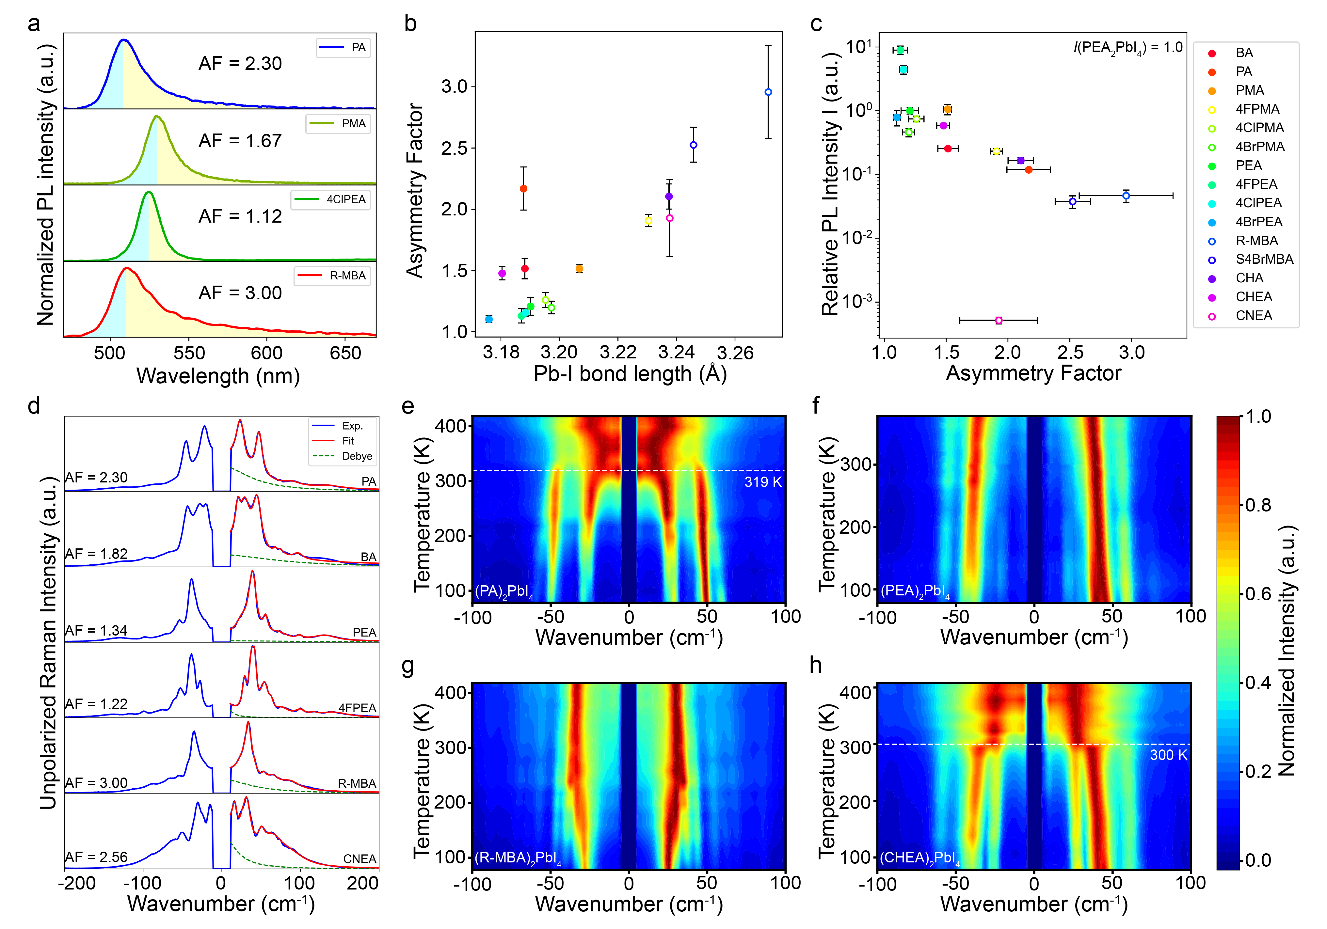
2.2 Correlating ns² LPE with PLQY
AF vs. Pb-I bond length
Relative PLQY vs. AF
Octahedral tilting 2D LHPs
(PA)₂PbI₄
(BA)₂PbI₄
Angew. Chem. Int. Ed. 2023, 62, e202304515.

Slide 16
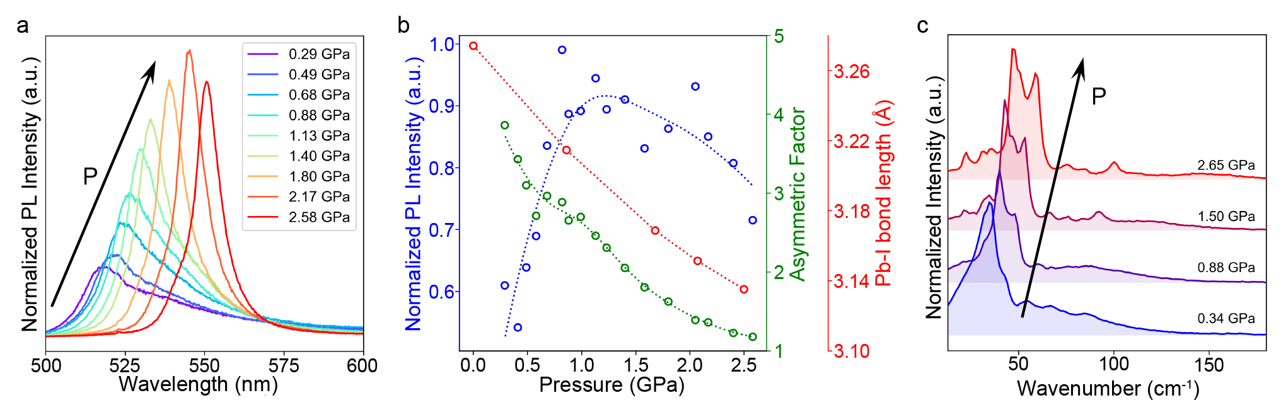
2.2 Correlating ns² LPE with PLQY
Shortening Pb-I bond Length by Pressure
As P increases:
- Pb-I bond length ↓;
- PL intensity ↑ then ↓;
- AF ↓;
- Raman peak frequency ↑;
- Raman central peak ↓;
All indicate less tendency of 6s² LPE because of the shortening of Pb-I bond length.
Angew. Chem. Int. Ed. 2023, 62, e202304515.

Slide 17
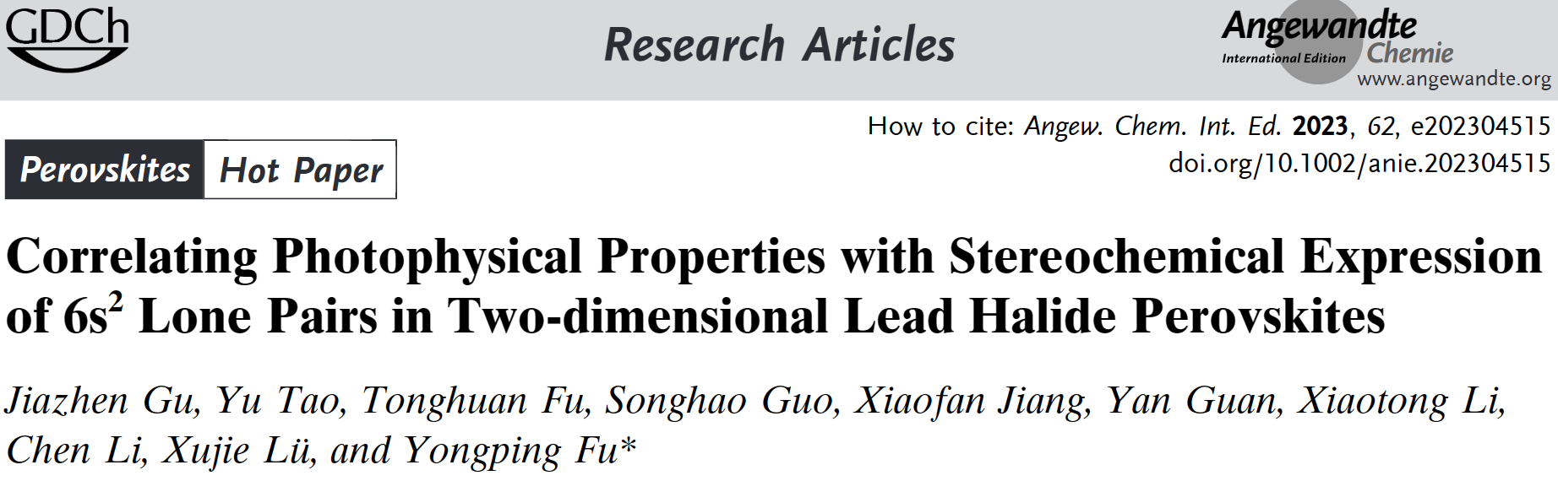
Details of this work are available online:

Slide 18
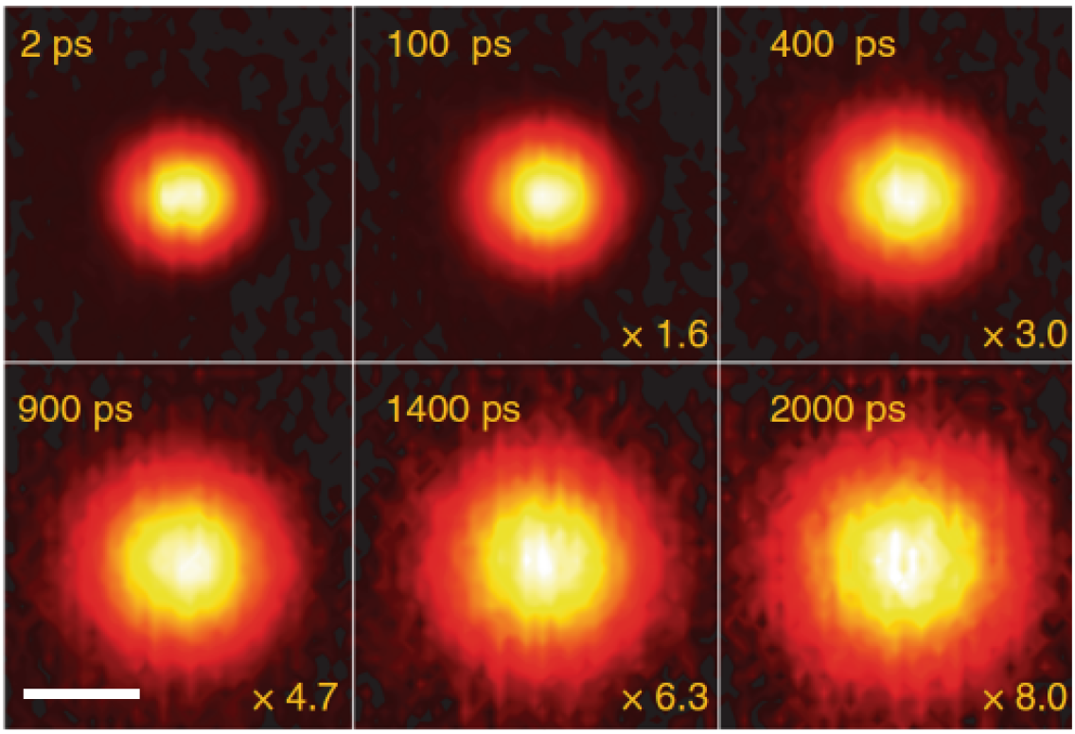
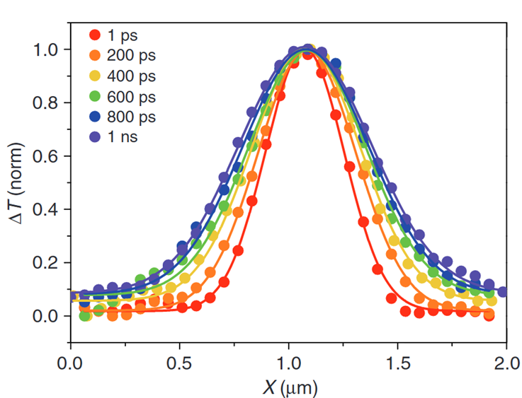
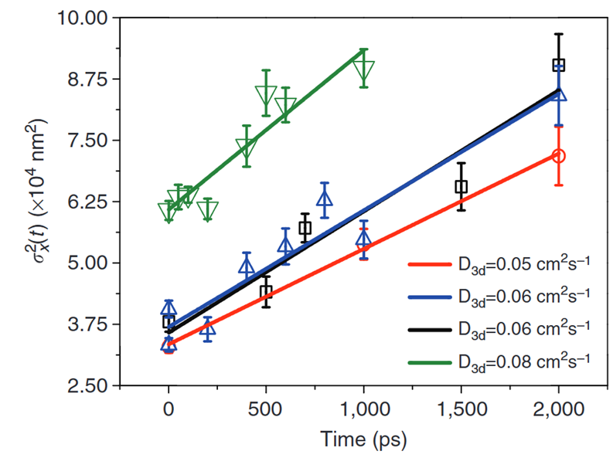
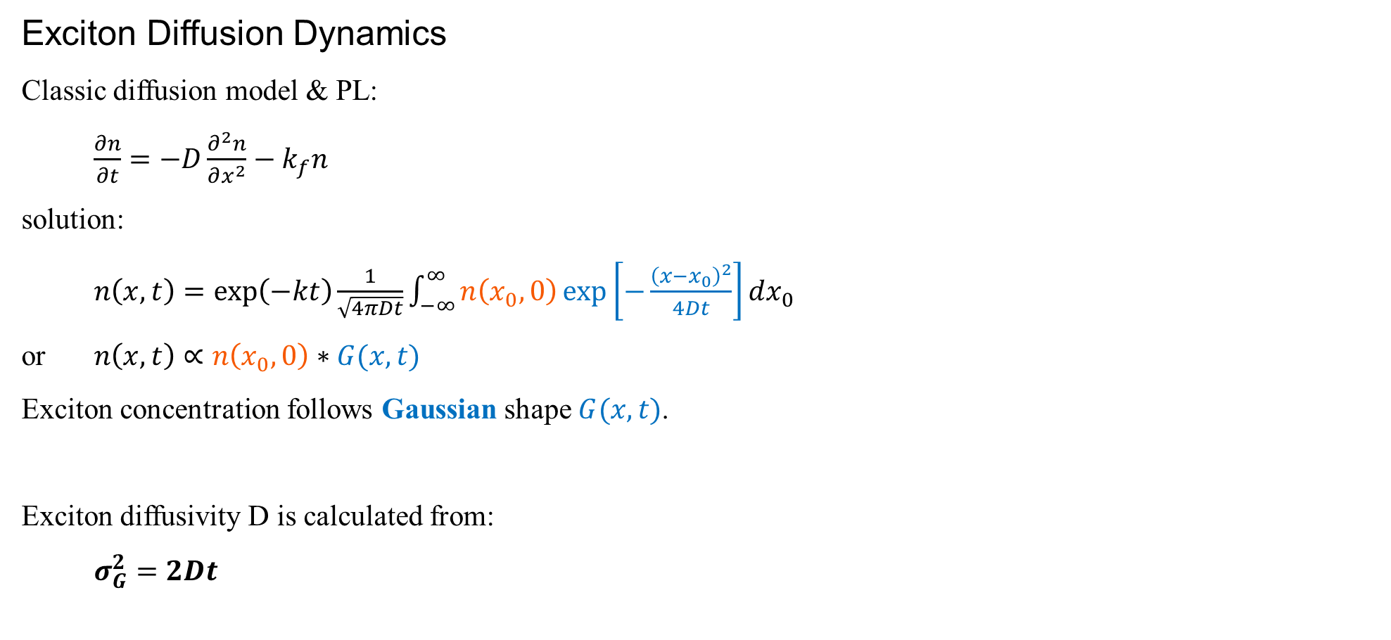
2.3 Measuring Exciton Diffusivity
Exciton Diffusion Dynamics
Classic diffusion model & PL:
$\frac{∂n}{∂t}=−D\frac{∂^{2}n}{∂x^{2}}−k_{f}n$
solution:
$n\left(x,t\right)=\exp\left(−kt\right)\frac{1}{\sqrt{4πDt}}\int_{−∞}^{∞}{n\left(x_{0},0\right)\exp\left[−\frac{{\left(x−x_{0}\right)}^{2}}{4Dt}\right]dx_{0}}$
or $n\left(x,t\right)∝n\left(x_{0},0\right)∗G(x,t)$
Exciton concentration follows Gaussian shape $G(x,t)$.
Exciton diffusivity D is calculated from:
$σ_{G}^{2}=2Dt$
Nat. Comm. 2020, 11, 664. Adv. Energy Mater. 2020, 10, 1903781.

Slide 19
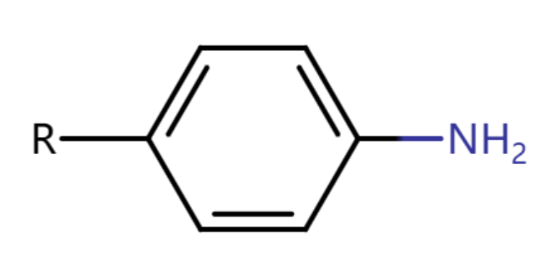
2.3 Measuring Exciton Diffusivity
Exciton Diffusivity of 2D LHPs
1. Rigidity dominates
4RAn series:
Rigid LA suppresses EPC, despite tilting
2. Distortion dominates
Tilting & ns² LPE enhance EPC;
Exciton scattering ↑, diffusivity ↓
LA Cation | Structural Distortion Type | Diffusivity (cm²s⁻¹)
4tFMPMA | Tilting | 4.730
4ClAn | Tilting | 2.174
4BrAn | Tilting | 1.458
4BuAn | Minor Tilting | 0.640
4FPEA | Intermediate | 0.613
PEA | Intermediate | 0.204
R-MBA | Off-center | 0.168
4DFCHA | Off-center | 0.020
PA | Tilting | 0.016
Rigidity dominating
EPC dominating
Unpublished

Slide 20
Part. 3
Future Plan
Enhancing LPE in other systems
LPE tuning exciton diffusivity
LPE tuning excited-state properties

Slide 21
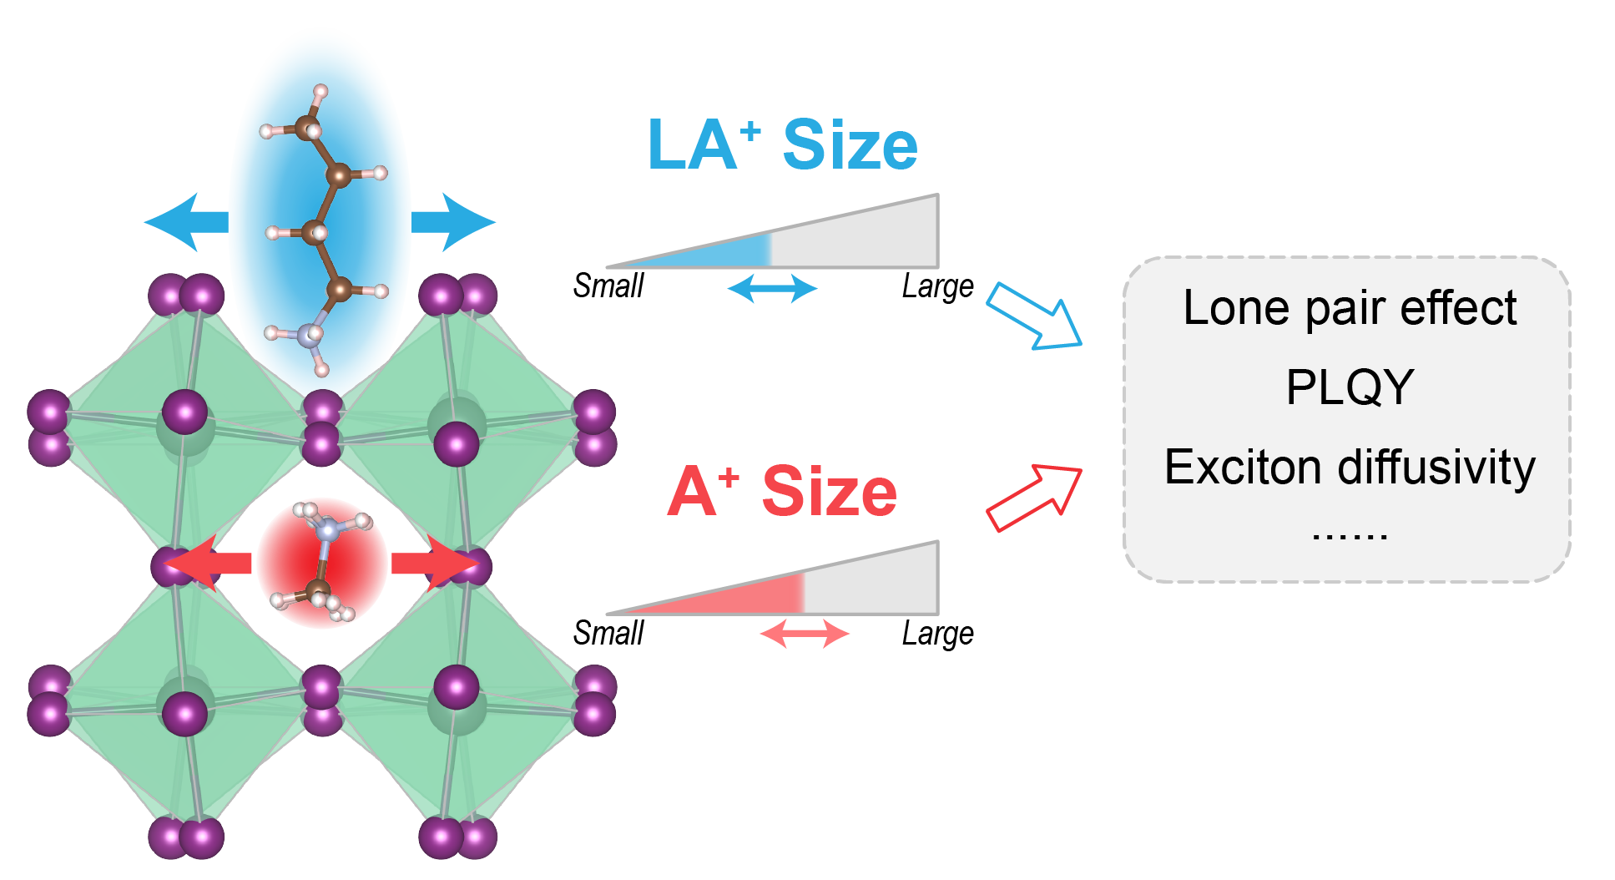
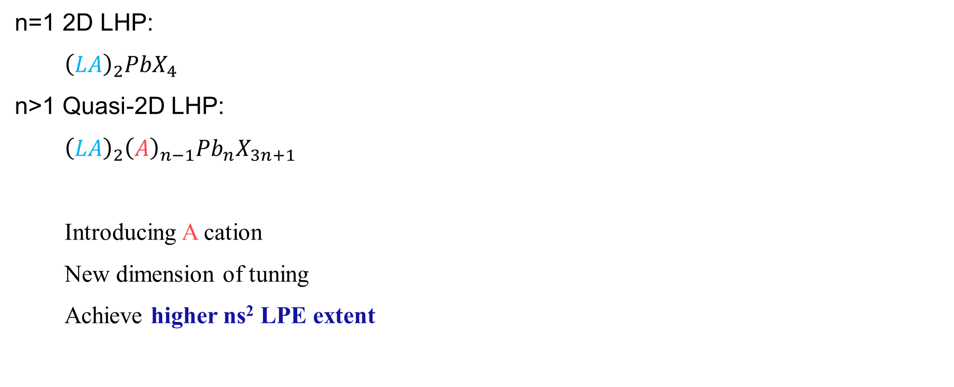
3.1 ns² LPE in Other Halide Perovskites
n=1 2D LHP:
${\left(LA\right)}_{2}PbX_{4}$
n>1 Quasi-2D LHP:
${\left(LA\right)}_{2}{\left(A\right)}_{n−1}Pb_{n}X_{3n+1}$
Introducing A cation
New dimension of tuning
Achieve higher ns² LPE extent

Slide 22
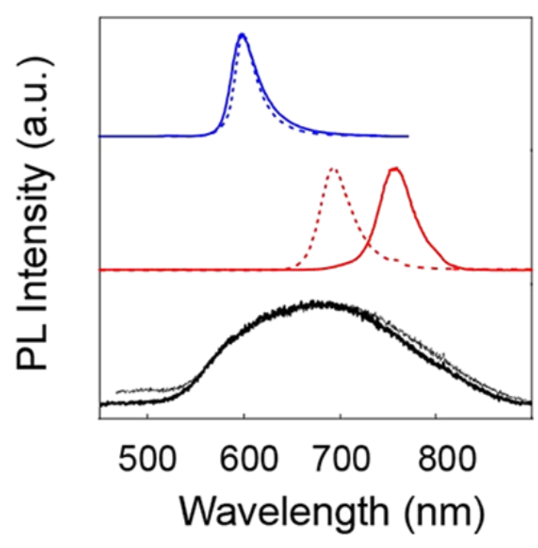
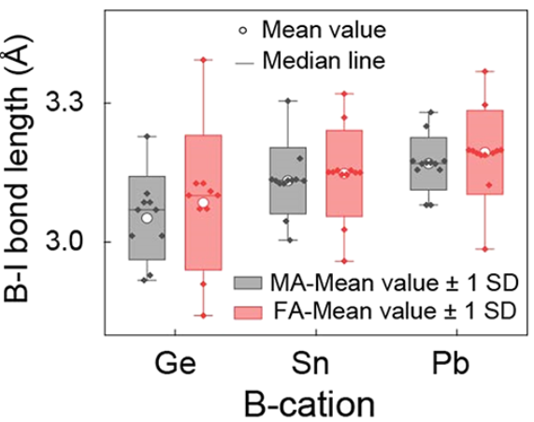
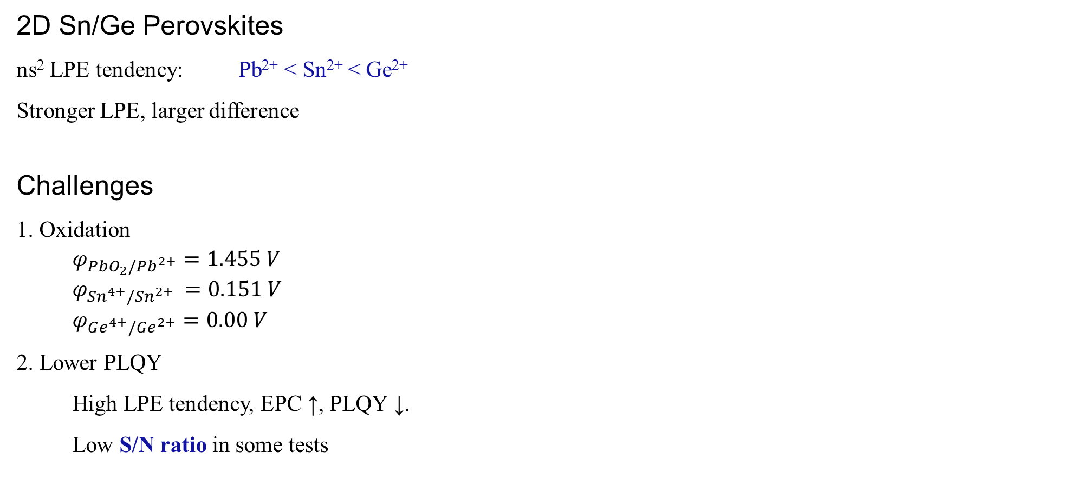
3.1 ns² LPE in Other Halide Perovskites
2D Sn/Ge Perovskites
ns² LPE tendency: Pb²⁺ < Sn²⁺ < Ge²⁺
Stronger LPE, larger difference
Challenges
1. Oxidation
$φ_{PbO_{2}/Pb^{2+}}=1.455 V$
$φ_{Sn^{4+}/Sn^{2+} }=0.151 V$
$φ_{Ge^{4+}/Ge^{2+}}=0.00 V$
2. Lower PLQY
High LPE tendency, EPC ↑, PLQY ↓.
Low S/N ratio in some tests
Pb
Sn
Ge
JACS, 2022, 144, 18030.

Slide 23
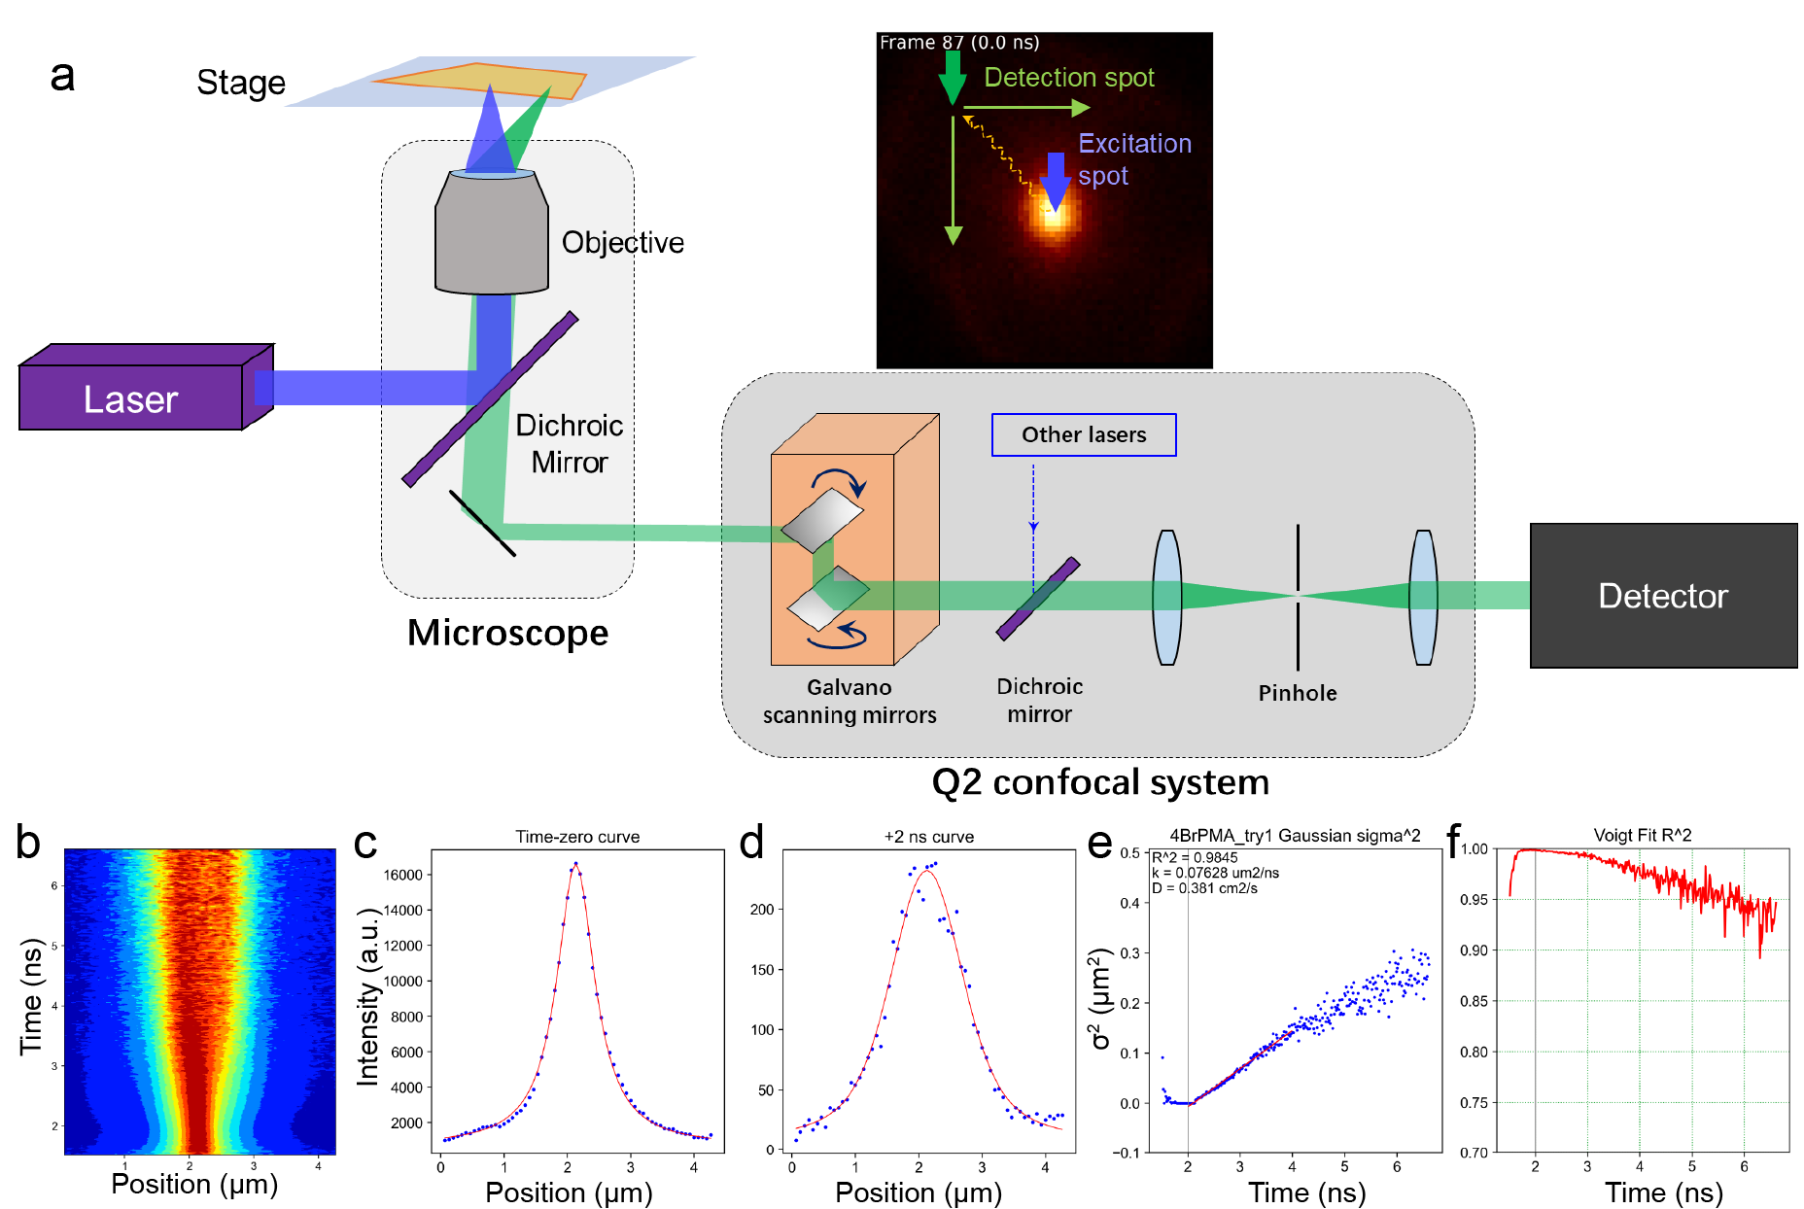

3.2 Measuring Exciton Diffusivity
Instruments
Data Analysis
LPE
Temperature
Excitation Power
Trap State
Exciton Diffusivity

Slide 24
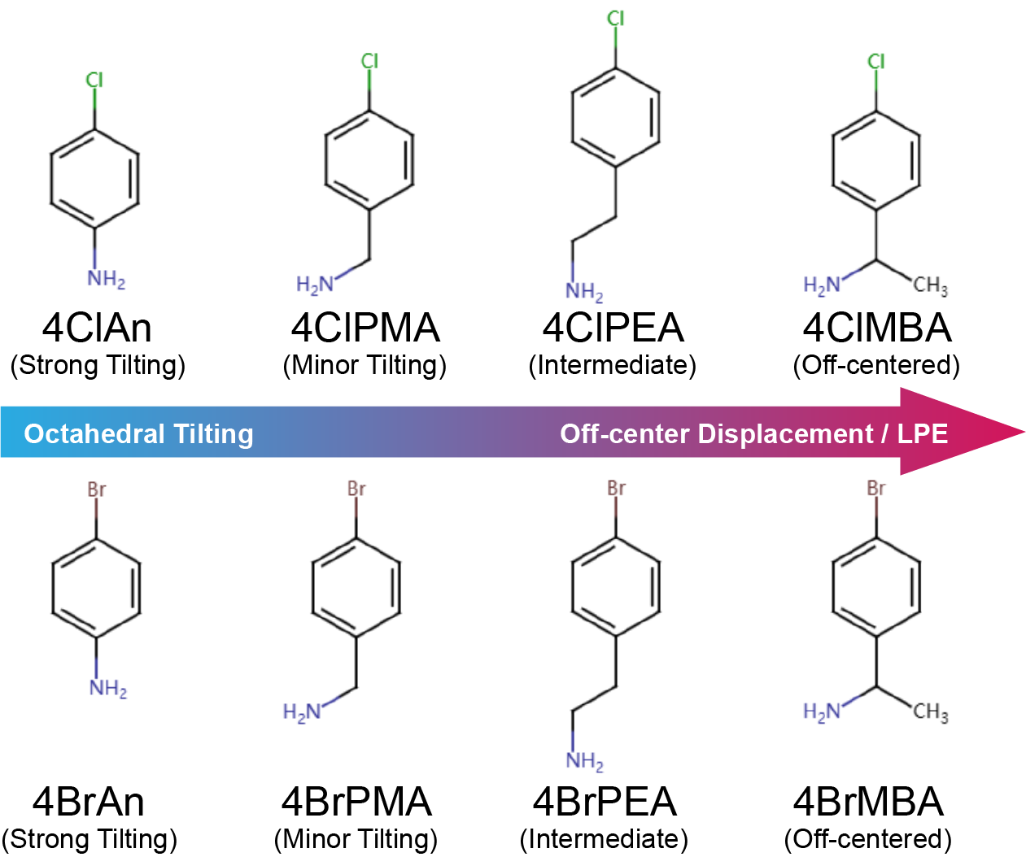
3.2 Measuring Exciton Diffusivity
New LA Series
Diffusivity ?

Slide 25
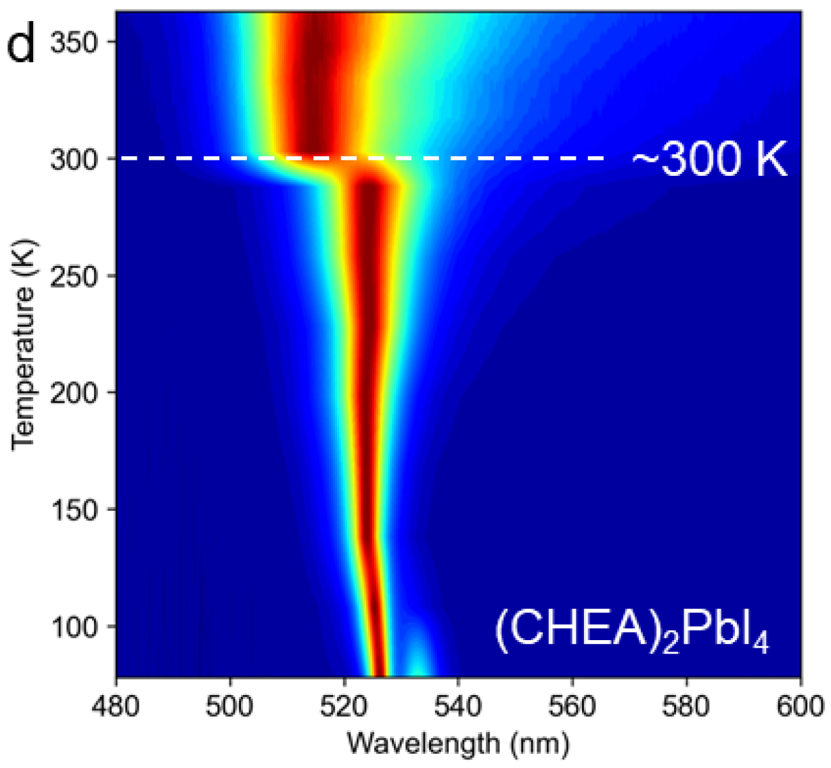
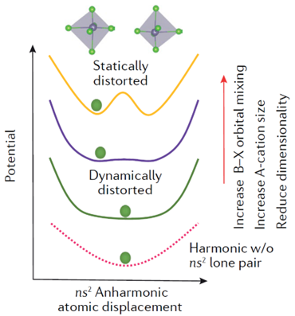


3.3 LPE-related Phase Transition
For double-well potential curve:
$k_{B}T<E_{a}$: Static LPE
$k_{B}T>E_{a}$: Dynamic LPE
Nat. Rev. Chem. 2021, 5, 838.
Notes:
Remove irrelevant figs

Slide 26






3.3 LPE-related Phase Transition
Coherent Phonon Spectrum
Lattice vibration frequency:
$\tilde{ν}=33 cm^{−1}$ $f=1 THz={10}^{12}Hz$
$T=1/f={10}^{−12}s=1 ps$
Lattice vibration timescale ≈ detection timescale
Upon vibration:
- dielectric constant $ε$;
- Refraction index $n$;
- Reflection $R$;
- Absorption $A$; ......
Time (ps)
Absorption Spectrum
Signal Oscillation $S(t)$
Fourier Transformation
Coherent Phonon Frequency $ν$
Phys. Rev. Mater. 2022, 6, 095401. J. Phys. Chem. Lett. 2022, 13, 4073.

Slide 27


Acknowledgements
DFT calculations:
Yu Tao
Dr. Chen Li @ PKU
High-pressure PL, Raman, PXRD:
Tonghuan Fu
Dr. Songhao Guo
Prof. Xujie Lü @ HPSTAR
Microscope tech support:
Dr. Yan Guan @ PKU
The Fu Lab 2023
Advisor: Dr. Yongping Fu
SCXRD refinement:
Xiaofan Jiang
Xinyu Li @ Fu Lab
Dr. Xiaotong Li @ Caltech

Slide 28
Thanks for your attention!

Slide 29





1.1 2D Halide Perovskites
Electronic Structure
Organic layer: HOMO - LUMO gap $E_{org}$
Inorganic layer: VBM - CBM bandgap $E_{g}$
In general, $E_{g}<E_{org}$ ==> Quantum Confinement
e⁻ and h⁺ trapped in inorganic layer, forming exciton
In inorganic layer:
VBM: (B²⁺ ns + X np)*
CBM: (B²⁺ np + X ns&np)*
Inorganic lattice dominates the excitonic properties.
CBM: (Pb np + I ns&np)*
VBM: (Pb ns + I np)*
Chem. Rev. 2019, 119, 3140. JACS, 2019, 141, 1171.

Slide 30


1.1 2D Halide Perovskites
Tuning the Properties
.
LA⁺ chemical engineering
ns² lone pair effect
Inorganic layer distortion
Exciton-phonon coupling
Emission wavelength
PLQY
Carrier
mobility
......

Slide 31




1.3 Exciton-Phonon Coupling (EPC)
How to Measure EPC Strength
Temperature-dependent Photoluminescence (TDPL)
Transient absorption &
Coherent phonon spectrum
Raman central peak
J. Phys. Chem. Lett. 2022, 13, 4073.

Slide 32





1.5 Exciton Diffusion
Lattice Rigidity
Energy Disorder
?
High-mobility semiconductor devices?
ns² LPE?
Nat. Comm. 2020, 11, 2035. Adv. Optical Mater. 2021, 9, 2001875
Notes:
to part 2 or:
add device importance

Slide 33


2.1 Structural Distortions in 2D LHP
ns² LPE in 3D LHP
t < 1 Undersized A⁺ Octahedral tilting
t ≈ 1 Intermediate A⁺ Tiniest distortion
t > 1 Oversized A⁺ Pb²⁺ off-center displacement
Tolerance factor:
$$t=\frac{R_{A}+R_{X}}{\sqrt{2}(R_{B}+R_{X})}$$
JACS, 2022, 144, 12247.

Slide 34

2.1 Structural Distortions in 2D LHP
ns² LPE in 2D LHP
"2. Pb off-centering is orientational:
R-MBA: in-plane off-centered
CHEA: out-of-plane off-centered"
LPE is correlated with the Pb-I elongation direction;
R-MBA (108.9 A³) expands horizontal Pb-I;
=> in-plane expansion & off-centering
CHEA (99.5 A³) expands vertical Pb-I;
=> out-of-plane expansion & off-centering
Such correlation is valid across 18 other samples.
(R-MBA)₂PbI₄
in-plane expansion
(CHEA)₂PbI₄
out-of-plane expansion
Angew. Chem. Int. Ed. 2023, 62, e202304515.

Slide 35

2.2 Origin of ns² LPE
Off-centering Vector
$l=r\left(Pb\right)−\frac{1}{6}\sum_{i=1}^{6}{r(I_{i})}$
Octahedral Coordinates
X axis: in-plane longer $\frac{1}{2}I−I$
Y axis: in-plane shorter $\frac{1}{2}I−I$
Z axis: out-of-plane $\frac{1}{2}I−I$
Projected Off-centering Vector
$l=k_{x}e_{x}+k_{y}e_{y}+k_{z}e_{z}$ $l:(k_{x}, k_{y}, k_{z})$
$e_{i}=\frac{1}{2}\left[r\left(I_{i+}\right)−r\left(I_{i−}\right)\right]$
Angew. Chem. Int. Ed. 2023, 62, e202304515.
Notes:
delete

Slide 36



2.2 Electron Localization Function (ELF)

Slide 37


2.4 ns² LPE and Exciton-Phonon Coupling
Raman Central Peak
Pb²⁺ hopping causes polar fluctuation
enhancing lattice anharmonicity & EPC
=> 0 cm⁻¹, broadband background
Results:
Octahedral tilting ---- Strong central peak
Intermediate ---------- Weak central peak
ns² LPE --------------- Strong central peak
Octahedral tilting
Intermediate
ns² LPE /
Pb off-centering
Angew. Chem. Int. Ed. 2023, 62, e202304515.

Slide 38

2.4 ns² LPE and Exciton-Phonon Coupling
Dynamic & Static Distortion
Nat. Rev. Chem. 2021, 5, 838. Angew. Chem. Int. Ed. 2023, 62, e202304515.

Slide 39


2.3 Measuring Exciton Diffusivity
Impact of Structural Distortion Type
We designed chemically similar LAs;
Diffusivity shows no trend due to trap-state emission.
LA Cation | Structural Distortion Type | Diffusivity (cm²s⁻¹)
2MePEA | Tilting | 0.262 ± 0.087
3MePEA | Off-center | 0.303 ± 0.107
4MePEA | Intermediate | 0.174 ± 0.051
Unpublished

Slide 40

2.7 Impact of Trap States
Free & Trapped Exciton Diffusion
Free Exciton (FE) Trapped Exciton (TE)
(4BrAn)₂PbI₄ shows strong TE emission;
FE and TE emissions can be separated by filters;
FE diffusion:
- Narrow Voigt distribution;
- "Accelerating" diffusion;
TE diffusion:
- Broad irregular distribution;
- "Decelerating" diffusion;
FE
TE
Unpublished

Slide 41










2.8 Exciton Diffusion Dynamics
Different shapes of σ²-t curve
straight line
r-shape
J-shape
S-shape
reverse-S

Slide 42









3.4 Hypothesis of Trapped Exciton Diffusion
Overall - normalized
A possible model
1. There's a defect saturation level $n_{0}$;
2. FE traps fast, while TE detraps slow;
($k_{t}≫k_{d}$)
3. FE has shorter lifetime than TE;
($τ_{FE}≪τ_{TE}$)
FE
TE
FE
$$k_{fF}$$
$$D_{FE}$$
$$k_{t}$$
$$k_{d}$$
$$n_{0}$$
$$D_{TE}$$
TE
Overall
Fluorescent Decay
Diffusion curve
$$k_{fT}$$

Slide 43
3.4 Hypothesis of Trapped Exciton Diffusion
1. Excitation
2. Trapping
3. Transition
4. TE-dominating
5. TE-diffusion
FE diffusion
TE diffusion
Peak shape evolution

